Slide 1

Welcome!!

Slide 2
WFSSVPDFIRPGO:
Are We There Yet?
  Kathleen Hebbeler, DaSy, ECTA, IDC
  Christina Kasprzak, ECTA, DaSy
  Joy Markowitz, IDC, DaSy
Improving Data, Improving Outcomes
September 2014

Slide 3
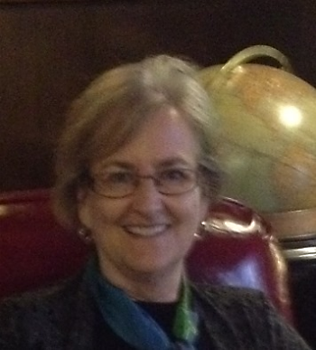
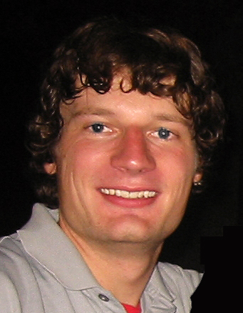

Much appreciation to…
Martha Diefendorf
Kellen Reid

Slide 4
And the Conference Planners
Core Team: Kathi Gillaspy, Chris Thacker, Anne Lucas, Sharon Walsh, Lisa Backer, Christine Robin Payne, Darla Gundler, Tony Ruggerio, and Danielle Crain
Advisory Team: Cornelia Taylor, Bruce Bull, Albert Wat, Verna Thompson, Donna Noyes, Ron Benham, Baron Rodriguez, Wesley Williams, Linda Lynch, and Silvia DeRuvo

Slide 5
ECIDEA14 Conference App
Our new conference app, EC IDEA14, provides easy-to-use interactive features to enhance your event experience
You’ll find the conference agenda, map, handouts, and even photos at your fingertips
We have conference staff available to help you get familiar with the app’s features

Slide 6
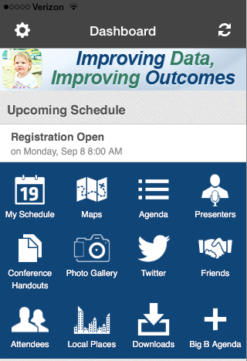
Dashboard
The Dashboard keeps you organized with up-to-the-minute Speaker and Event information.

Slide 7
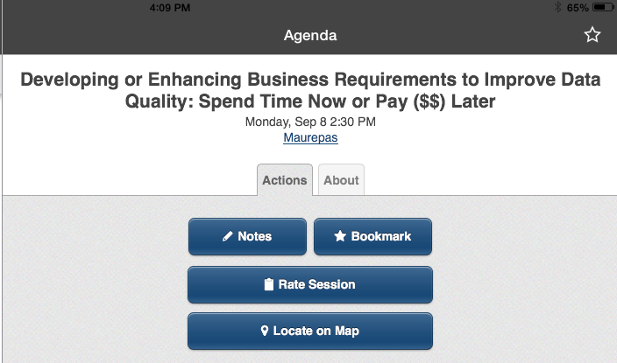
Agenda
Browse the agenda by day, topic, or session type
Bookmark sessions to build your personal calendar
Find session handouts, take notes, or rate sessions

Slide 8
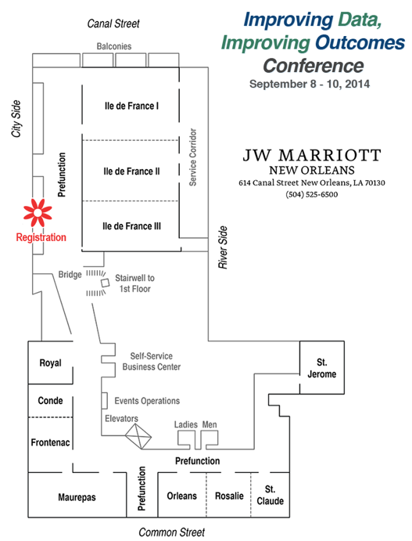
Conference Map
Find your next session on the built-in map of conference rooms

Slide 9
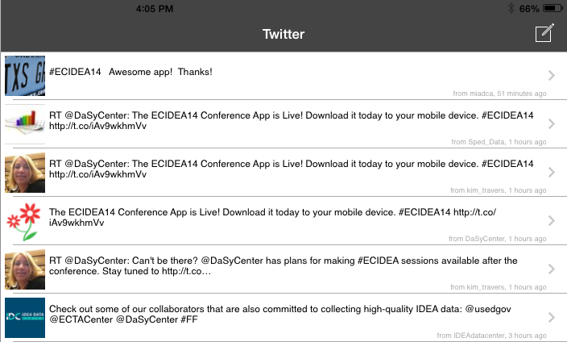
Twitter Feed
Built-in Twitter feed to follow news and share session information.
Presenters: Tweet your session using #ECIDEA14!

Slide 10
Downloading the App
For iOS and Android devices: visit the App Store or GooglePlay Store on your device and search for “Improving Outcomes.”
For All Other Phone Types (including BlackBerry and all other web browser-enabled phones): point your mobile browser to app.core-apps.com/ecidea14
Get help at the registration desk.

Slide 11
Evaluations
For each session – in the app
For the overall conference – will come to you in an email.
The input is invaluable to us and to OSEP. Please complete your evaluations.

Slide 12
The Overall EC Equation
W F S S +
V P D +
F I R P =
G O
Notes:
Who thinks they cracked the code? Does this arrangement help?
I am going to move through these pieces one at a time.

Slide 13

Good Outcomes
It is all that matters.
Everything else is in the service of helping children and their families achieve good outcomes.
Outcomes are especially important in early childhood.

Slide 14
Why we intervene when children are young
The Importance of Developmental Trajectories
Age in Months

Slide 15

Some important distinctions
EI and ECSE programs can work (potential)
≠
EI and ECSE programs in my state/district do work
≠
EI and ECSE programs in my state/district are working as effectively as they can
Notes:
The elephant in the room in is quality.

Slide 16
The Overall EC Equation
W F S S +
V P D +
F I R P =
G O

Slide 17
What makes the difference?
Faithfully Implemented Recommended Practices

Slide 18
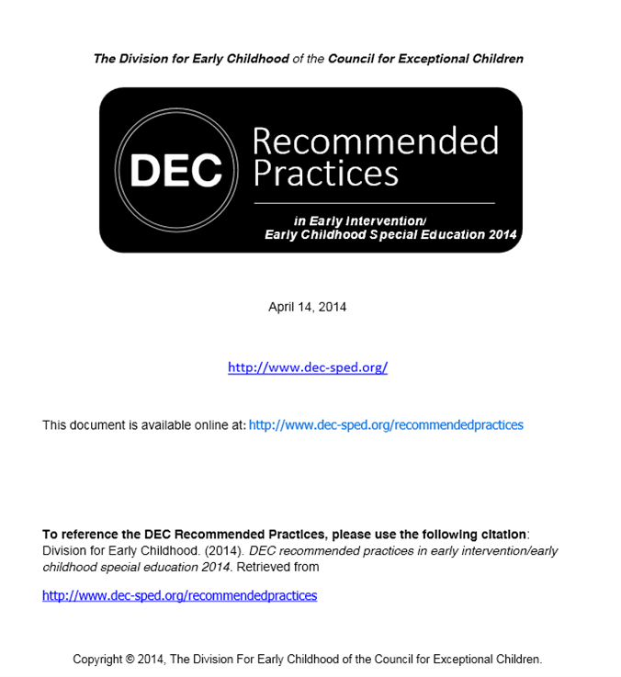
DEC Recommended Practices
…to provide guidance to practitioners
and families about the most effective ways to improve the learning outcomes and promote the development of young children, birth through five years of age, who have or are at-risk for developmental delays or disabilities.

Slide 19
EC IDEA14: Learn more about practices…
Measures of Engagement, Independence, and Social Relationships
Leadership and DEC Recommended Practices
Developing Collaborative Screening Systems
Inclusion at the Earliest Ages
Part C (619): Planning for Effective Implementation of effective practices

Slide 20
The Overall EC Equation
W F S S +
V P D +
F I R P =
G O

Slide 21
What supports the faithful implementation of Recommended Practices?
A Well Functioning State System
(And a stateful of WFLSs.)

Slide 22
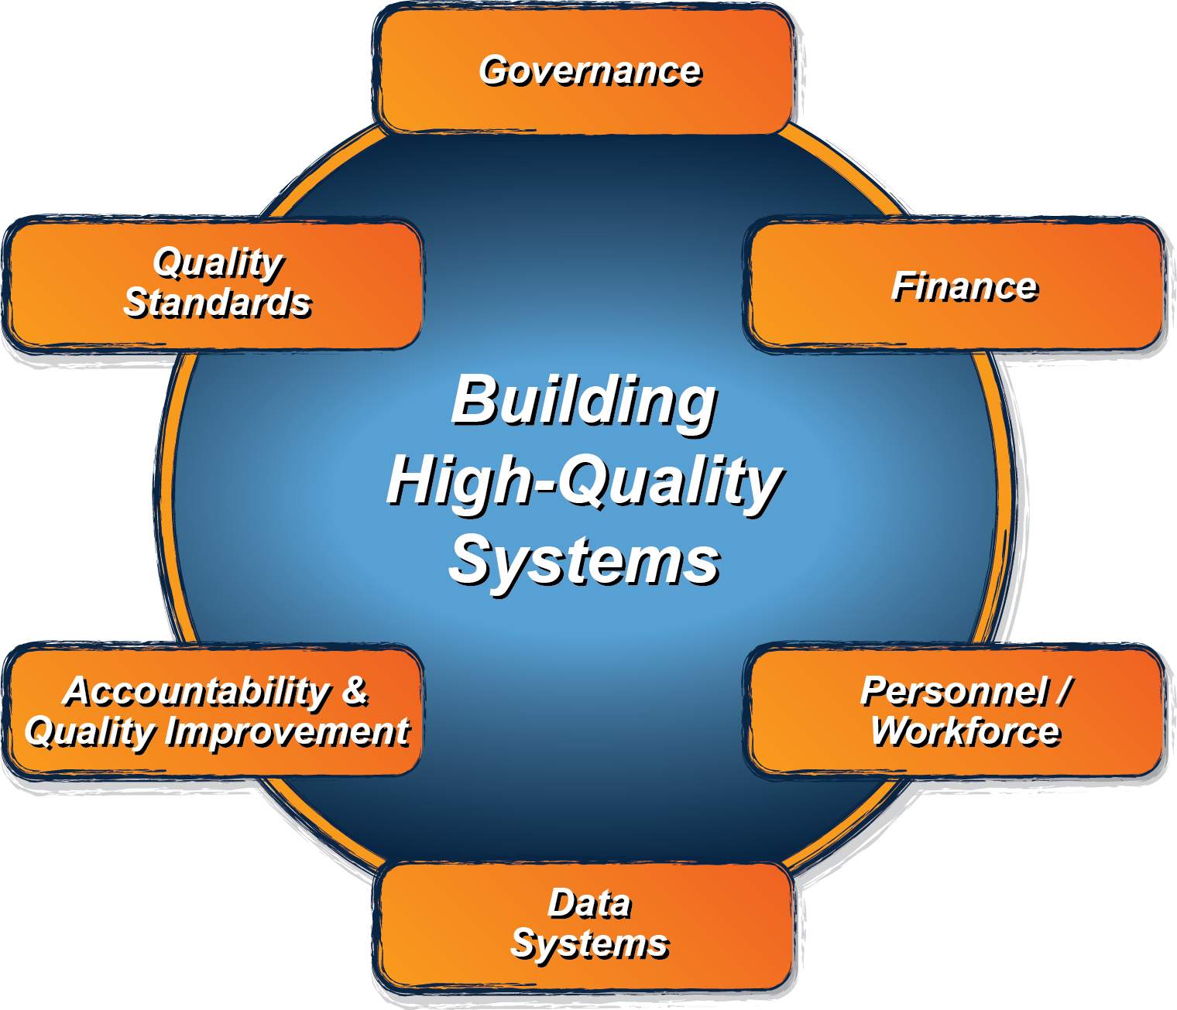
ECTA System Framework
What does a state need to put into place in order to encourage, support, require local implementation of effective practices?
ectacenter.org/sysframe

Slide 23
EC IDEA14: Learn more about building well functioning systems…
INSPIRE ACTION to Improve Outcomes
What It takes: Scaling up Implementation of RP
Determining the Quality of Your Finance System
Theory of Action: Telling Your SSIP Story
Building High Quality Personnel Systems
Tapping Teacher Evaluation: Using Child-Level Data
Building Better Systems, Implementing Recommended Practices

Slide 24
The Overall EC Equation
W F S S +
V P D +
F I R P =
G O

Slide 25
What do you need to have to know if you have GO, FIRP and WFSS?
Valid and Powerful Data

Slide 26
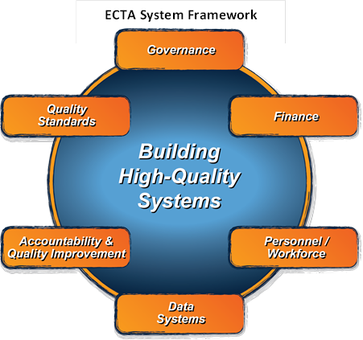
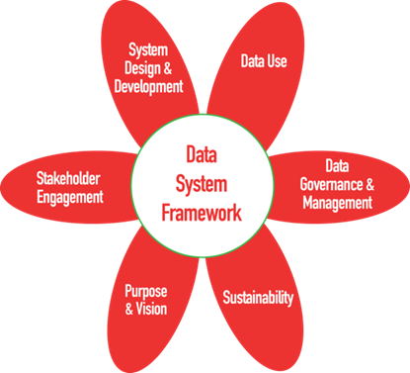

Slide 27
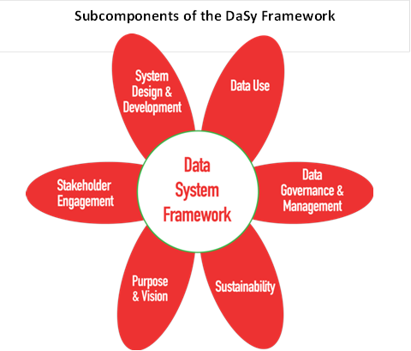
Notes:
Data system defined broadly.

Slide 28

Contributors to the DaSy Framework

Slide 29

Purpose of the DaSy Data System Framework
Assist Part C and Section 619 state staff in developing and enhancing high-quality state data systems and in improving the quality of their IDEA data.

Slide 30
Broad Definition of Data System
Data System refers to the hardware, software, and other applications that enable Part C and Section 619 programs to collect data about children, families, workforce, and/or program characteristics (e.g., program quality), as well as the analysis, reporting, and data use practices associated with those data.
Notes:
Collection, the processing, the using, the reporting, -- all of those are addressed in the framework

Slide 31
Framework: 3 Major Uses of Data
Accountability
  Federal reporting
  Reporting to state legislature
Program Improvement
  Identifying strengths and weaknesses
  Planning and tracking effectiveness of improvement strategies
Program Operations
  Day-to-day program functions such as billing, timeline tracking, web-based IFSPs and IEPs

Slide 32
Framework Development
Literature Review for each subcomponent
Discussions with partners states about their current status regarding the subcomponent
Draft Quality Indicators and Elements
  Multiple rounds of review and revise by staff and partner states
  Review by group of external reviewers
Ongoing coordination with ECTA and ECIDS team

Slide 33



The Framework Development Process
I like “data systems” better than “data system(s)”.
Are we saying “Section 619” or just “619”?
Is staff singular or plural?
We should say “periodically” instead of “regularly.”

Slide 34
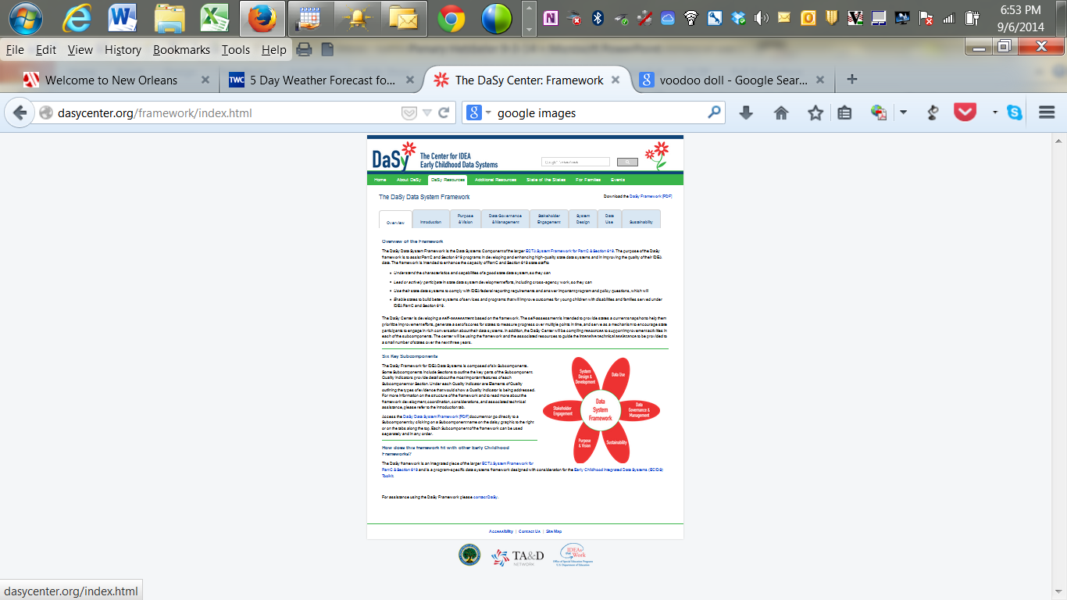
Check it out!
http://dasycenter.org/

Slide 35
Next Steps for the Data System Framework
Self Assessment
  Underdevelopment in conjunction with ECTA
Resources
  Will be compiling and linking to subcomponents
Intensive TA
  Use the framework to guide intensive data system improvement efforts including building an integrated EC data system
  5 states in 2014, 5 more states in 2015

Slide 36
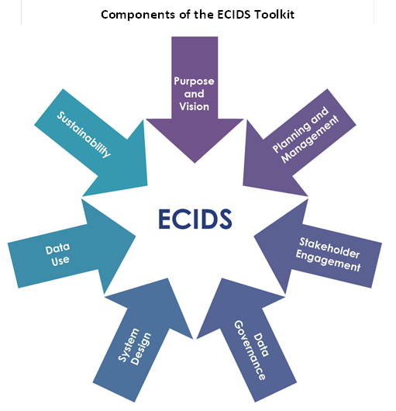
Early Childhood Integrated Data System

Slide 37
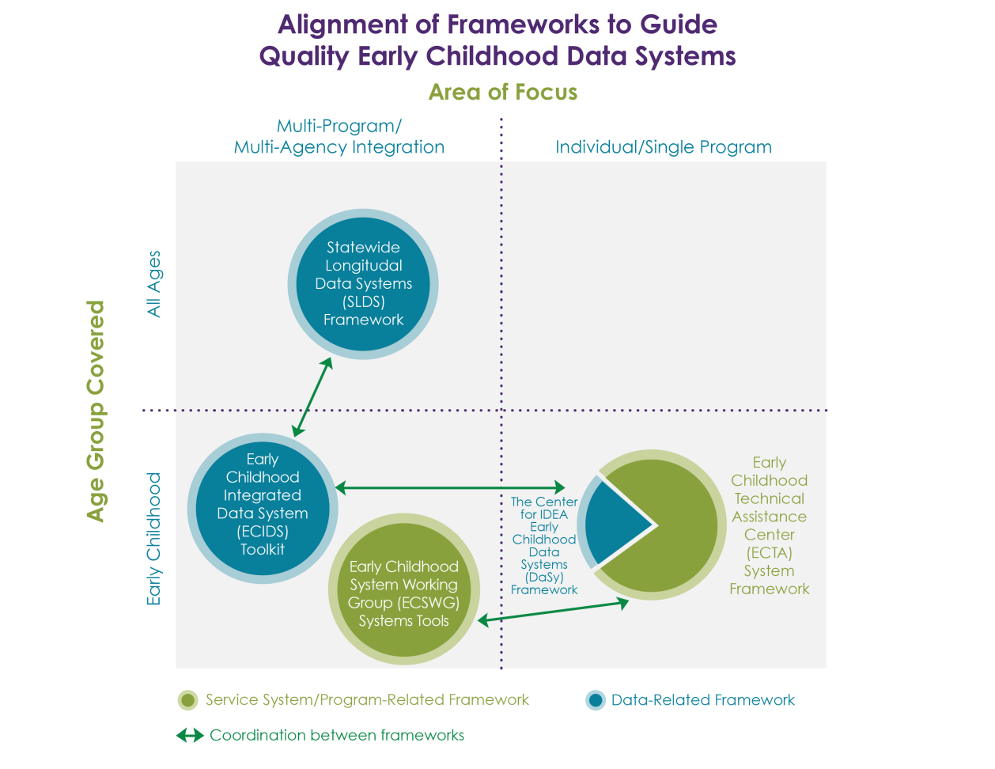

Slide 38
ED IDEA14: Learn more about high quality data systems (includes data use)
Michael Kogan’s plenary
Data Governance Demystified
Developing or Enhancing Business Requirements
Under the Hood with DaSy System Design and Development
Digging into “Data Use”
ECIDS and DaSy: Frameworks for Building Better Data Systems

Slide 39
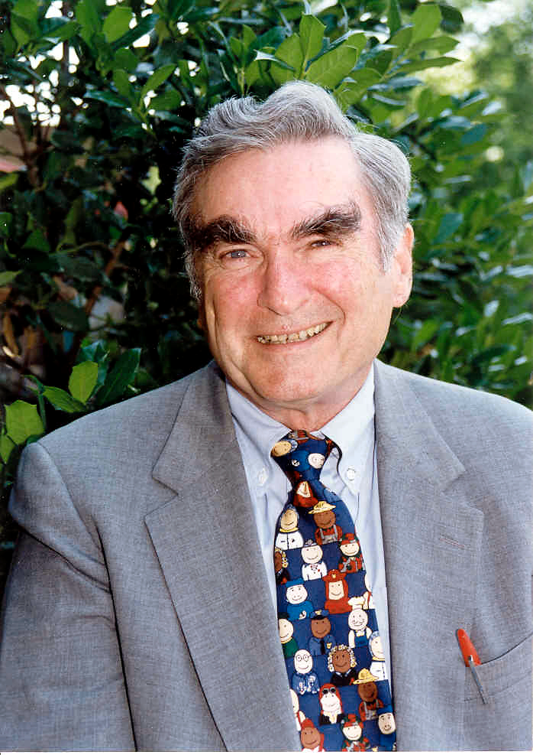
Jim Gallagher
First Chief of the Bureau of Education for the Handicapped
Used federal funds to create the first model demonstration programs for young children with disabilities
Proposed that technical assistance support these programs.

Slide 40
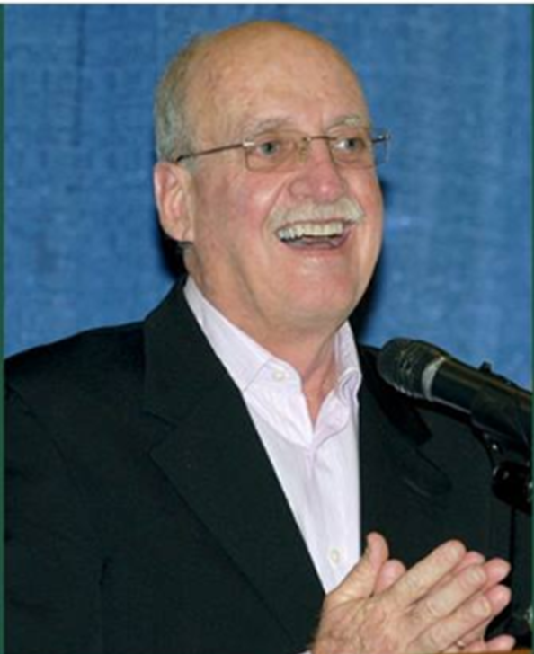
Fred Weintraub
Directed state and Federal legislative advocacy at Council for Exceptional Children for over 20 years
One of the architects of PL 94-142 (Education for All Handicapped Children Act)

Slide 41
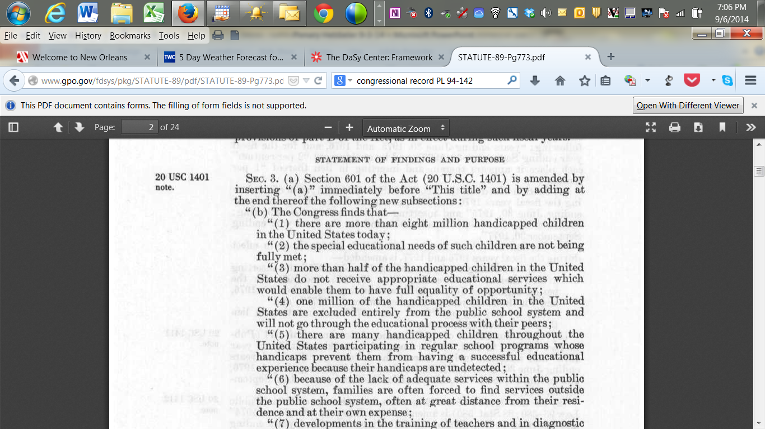

Slide 42

Vision: Daily Data Users
“I don’t have time to look at my data. I need to ….”
You are state leaders.
There is nothing that makes sense to complete that statement.
Regular use of data should be a fundamental part of every administrator’s, every TA provider’s, every teacher’s, every therapist’s job.

Slide 43
Barriers to the vision
“I don’t have (or have easy access to) the data I need.
This is a fixable problem.
But it is a very real problem.

Slide 44


Which data system do you have?
or
Notes:
Coming back to VPD. I was thinking that some state data system are Ferrari and some are well, let’s just say some are not.

Slide 45
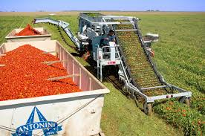
The technology depends on the input to produce value.
Notes:
The tomato harvester is a powerful tool but it is useless without the tomatoes.

Slide 46
Seeing Data as a Resource
Resource that needs to be cultivated
Needs to be protected.
Need systematic efforts to build the infrastructure to collect it, store it, analyze it, use it.
  See DaSy Data System and ECO Child and Family Outcomes Frameworks
Notes:
Where is your evidence?

Slide 47
Does your state have Valid data?
Achieving high quality data is a cross-cutting them in the DaSy’s framework.
Represented in multiple subcomponents.
Central to DaSy’s and IDC’s missions.

Slide 48
Does your state have Powerful data?
Powerful = data needed to answer important questions.
See QI4 in the DaSy Framework for a list of recommended data elements
Difficult to make use of outcomes data (think SSIP) without data that can address questions such as
  Who has good outcomes?
  What is producing good outcomes?
  What program features are related to good outcomes?

Slide 49
What data do you have on implementation? Service quality? Program quality? Service model? Curriculum?
FIRP
[G]O
Data???
Data
Note: All of these things are actionable.

Slide 50
Uniqueness of IDEA in the EC world
Oversight: Federal -> State -> Local
Funding: Federal -> State -> Local
Data: Local -> State -> Federal
Importance of valid data in supporting both the oversight functions and continued funding.
With SSIP, data is critical to systemic program improvement.

Slide 51
Collaboration across Centers
Coming Soon to Pt. C and 619 Coordinators:
Intensive TA Interest Inventory
  Watch for it
Who to Call
  The TA Centers work together

Slide 52




We look for the person(s) with the expertise to help you
DaSy, ECTA, IDC
IDC, DaSy
ECTA, DaSy

Slide 53
Remember the Overall EC Equation
Well Functioning State Systems +
Valid Powerful Data +
Faithfully Implemented Recommended Practices =
Good Outcomes

Slide 54

Welcome to NOLA!
Enjoy the
Conference!
Bad
Data

Slide 55



The contents of this presentation were developed under a grant from the U.S. Department of Education, #H373Z120002. However, those contents do not necessarily represent the policy of the U.S. Department of Education, and you should not assume endorsement by the Federal Government. Project Officers, Meredith Miceli and Richelle Davis.
Notes:
Instructions to presenters: This slide is to be included as the last slide in your deck but you are not expected to show it to the audience. Please be sure to delete these instructions from this slide’s notes page in your presentation.

