Slide 1
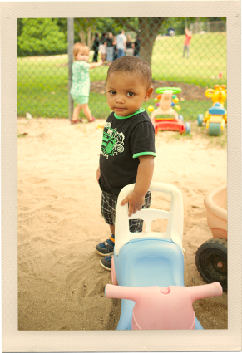
Building Better Systems, Implementing Recommended Practices
Improving Data, Improving Outcomes Conference
September, 2014
Carol Trivette
Betsy Ayankoya
Christina Kasprzak

Slide 2
What we’ll cover:
Review of the revised DEC Recommended Practices
Review of what it means to have a quality system to support implementation of RPs
Discussions about three areas of RPs: assessment, family, teaming and collaboration
Discussions about building effective systems to support RPs

Slide 3
DEC Recommended Practices
DEC initiative to bridge the gap between research and practice.
Provide guidance to practitioners & families about the most effective ways to improve learning outcomes & promote development of young children (0-5 yrs) who have or at risk for developmental delays or disabilities.
Used by individuals across a variety of early childhood settings.
Notes:
1991: DEC produced the first set of RPs. This set was based on practices generated by focus groups and a field validation
2000: updated & revised with review of the research literature, new focus groups and a new field validation.
2005: 240 RPs, 5 direct service strands,
2 indirect service strands.

Slide 4
Original RP Commission Members
Notes:
Over the past 18 months, a 13 member Recommended Practices Commission appointed by DEC has been working with the support of the ECTA Center to guide the revisions process.
The goal of the Recommended Practices is to inform and improve the quality of services provided to young children with or at risk of disabilities or delays and their families.

Slide 5
Task: Revision and Validation of Division for Early Childhood (DEC) Recommended Practices
Use systematic processes to revise the practices and increase their implementation and widespread use in collaboration with ECTA
Narrow existing list of 240 practices and revise practice statements as appropriate
Set of explicit parameters and criteria
Notes:
RP Commission Framework, Parameters, Definitions
ECTA Support
Topic Work Groups:
Develop practices and nominate evidence.
Commission reviews practices and evidence nominated. Provides feedback.
Topic Work Groups: Revise practices and nominated evidence.
Ongoing validation of evidence

Slide 6
Parameters
Birth-5 not limited to those eligible for IDEA services
“Essential”, “biggest bang” or highest leverage/impact practices
Observable, in active voice
Not disability specific
Can be delivered in all settings including natural/inclusive environments
Should build on, not duplicate, standards for typical early childhood settings (e.g. DAP)
Notes:
Population: birth-5 (through kindergarten), who have or are at risk for developmental delays and disabilities; not limited to those eligible for IDEA services (e.g. children with severe challenging behavior)
“essential”, “biggest bang” or highest leverage/impact practices
Practices represent the breadth of the topic
Observable, in active voice
Practices are not disability specific
Practices can be delivered in all settings including natural/inclusive environments
Practices should build on, but not duplicate, standards for typical early childhood settings (e.g. DAP)

Slide 7
Eight Topic Areas
Instruction (13)
Interaction (5)
Teaming & Collaboration (5)
Transition (2)
Leadership (14)
Assessment (11)
Environment (6)
Family (10)

Slide 8
Leadership (14)
L9. Leaders develop and implement an evidence-based professional development system or approach that provides practitioners a variety of supports to ensure they have the knowledge and skills needed to implement the DEC Recommended Practices.
L13. Leaders promote efficient and coordinated service delivery for children and families by creating the conditions for practitioners from multiple disciplines and the family to work together as a team.

Slide 9
Assessment (11)
A1. Practitioners work together with the family to identify family preferences for assessment processes.
A3. Practitioners use assessment materials and strategies that are appropriate for the child’s age and level of development and accommodate the child’s sensory, physical, communication, cultural, linguistic, social, and emotional characteristics.

Slide 10
Environment (6)
E1. Practitioners provide services and supports in natural and inclusive environments during daily routines and activities to promote the child’s access to and participation in learning experiences.
E4. Practitioners work with families and other adults to identify each child’s needs for assistive technology to promote access to and participation in learning experiences.

Slide 11
Family (10)
F3. Practitioners are responsive to the family’s concerns, priorities, and changing life circumstances.
F5. Practitioners support family functioning, promote family confidence and competence, and strengthen family-child relationships by acting in ways that recognize and build on family strengths and capacities.

Slide 12
Instruction (13)
INS4. Practitioners plan for and provide the level of support, accommodations, and adaptations needed for the child to access, participate, and learn within and across activities and routines.
INS13. Practitioners use coaching or consultation strategies with primary caregivers or other adults to facilitate positive adult-child interactions and instruction intentionally designed to promote child learning and development.

Slide 13
Interaction (5)
INT2. Practitioners promote the child’s social development by encouraging the child to initiate or sustain positive interactions with other children and adults during routines and activities through modeling, teaching, feedback, or other types of guided support.
INT5. Practitioners promote the child’s problem-solving behavior by observing, interpreting, and scaffolding in response to the child’s growing level of autonomy and self-regulation.

Slide 14
Teaming and Collaboration (5)
TC1. Practitioners representing multiple disciplines and families work together as a team to plan and implement supports and services to meet the unique needs of each child and family.
TC5. Practitioners and families may collaborate with each other to identify one practitioner from the team who serves as the primary liaison between the family and other team members based on child and family priorities and needs.

Slide 15
Transition (2)
TR1. Practitioners in sending and receiving programs exchange information before, during, and after transition about practices most likely to support the child’s successful adjustment and positive outcomes.
TR2. Practitioners use a variety of planned and timely strategies with the child and family before, during, and after the transition to support successful adjustment and positive outcomes for both the child and family.

Slide 16
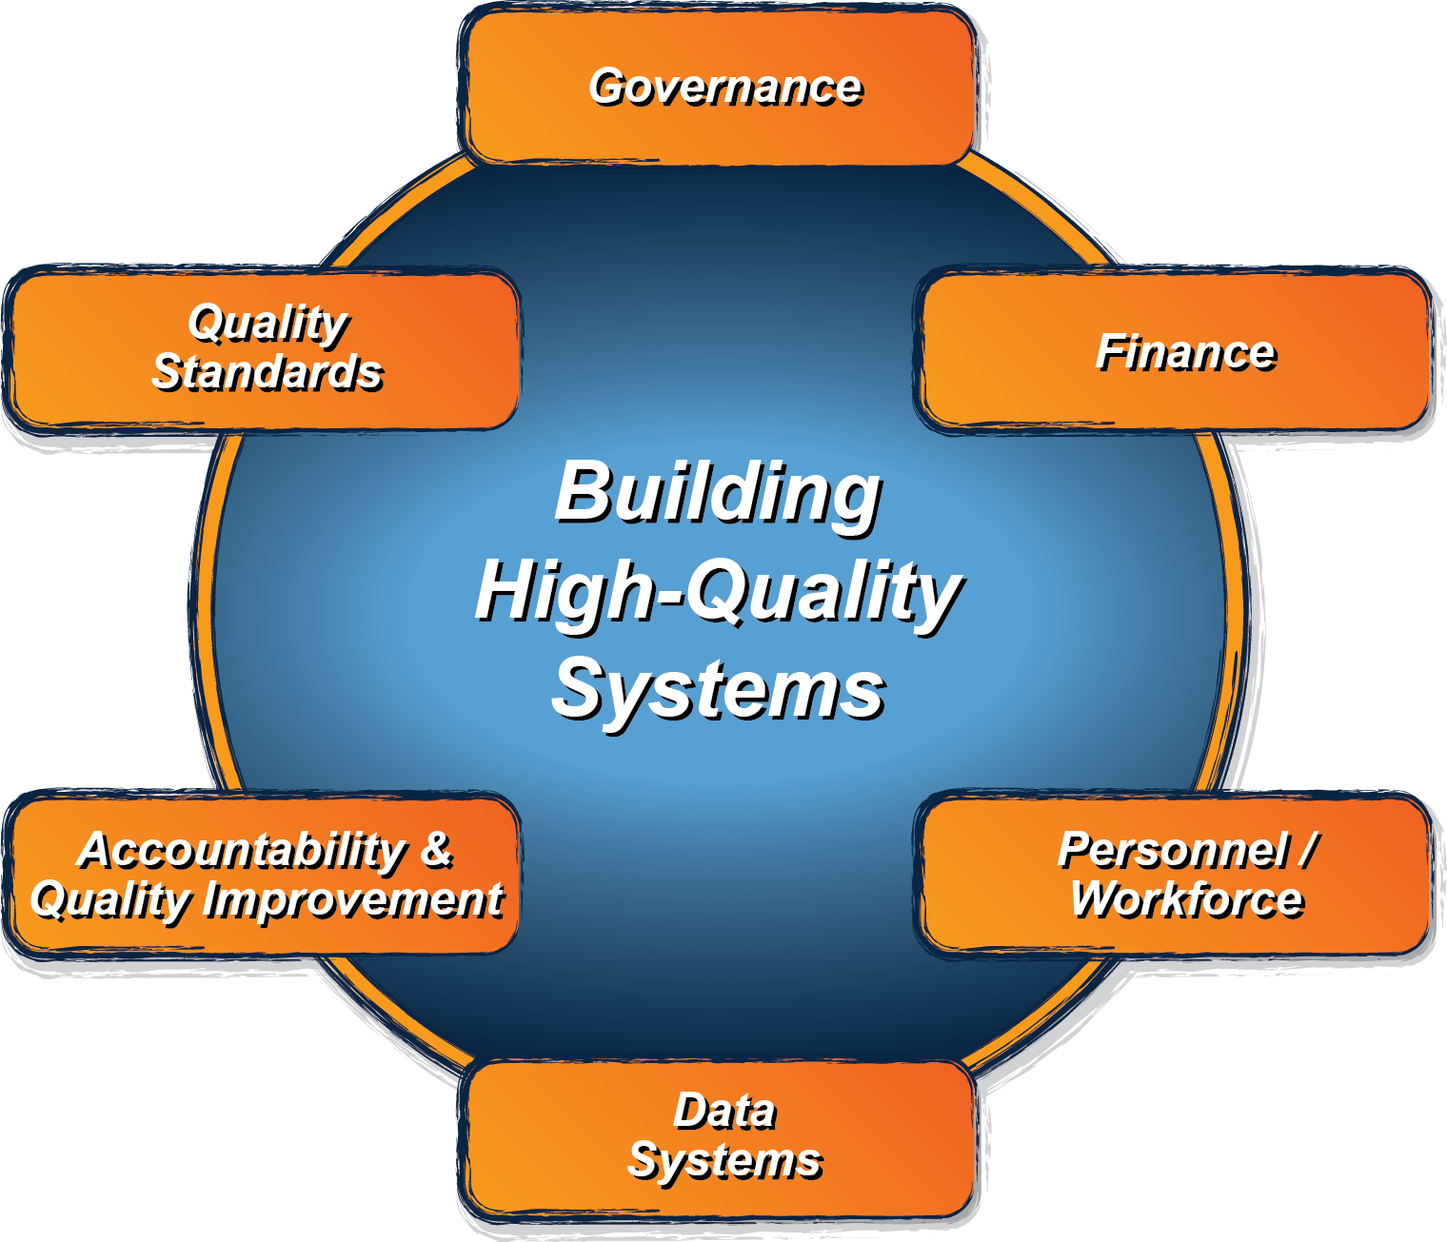
What does a state need to put into place in order to encourage, support, require local implementation of effective practices?

Slide 17
System Framework: Purpose and Audience
Purpose: to guide states in evaluating their current Part C/619 system, identifying areas for improvement, and providing direction on how to develop a more effective, efficient Part C and Section 619 system that requires, supports, and encourages implementation of effective practices.
Audience: the key audience is state Part C and state Section 619 coordinators and staff, with acknowledgement that other key staff and leadership in a state will need to be involved.

Slide 18
System Framework: Process and Partners
Iterative validation process: the framework is being developed through an iterative process among national and state experts in the field.
Partner states: the framework is being developed iteratively with 6 states (DE, ID, MN, NJ, PA, WV), so that it reflects (and is applicable to) the diversity of state systems (e.g. Lead Agency, eligibility criteria).
Technical Work Group (TWG): the Center has a technical work group (TWG) with experts in the field to advise the Center by providing early input on the elements, and later review and give input on drafts, as well as contribute resources available to support states on various elements.
Notes:
Generally speaking, we will be engaging in an iterative validation process that will include state partners as well as this technical work group. This means that we will work collaboratively with the state folks and with this group to draft ideas, review and edit those ideas (over and over so that each iteration is an improvement on the last), and then (when ready) we will share more refined ideas in a broader sense to more folks in the field for additional refinement.
We recently identified our 6 partner states – DE, ID, MN, NJ, PA & WV. They applied to be a partner states, so these are the final six selected and they represent some diversity across demographics (like size of state, and region of the country) as well as diversity in some state systems aspects (such as Lead Agency for Part C and eligibility criteria).
Our Technical Work Group – you all – are a second key group that we’ll be working with throughout the iterative process. You were selected because of your expertise in knowing the Part C and Section 619 programs and/or your general expertise around quality systems and systems building. So we have some diversity within this group –some folks having more research experience, some more TA and consulting; we have diversity with some folks who know Part C and/or Section 619 particularly well, others who understand the general early childhood and systems building.

Slide 19
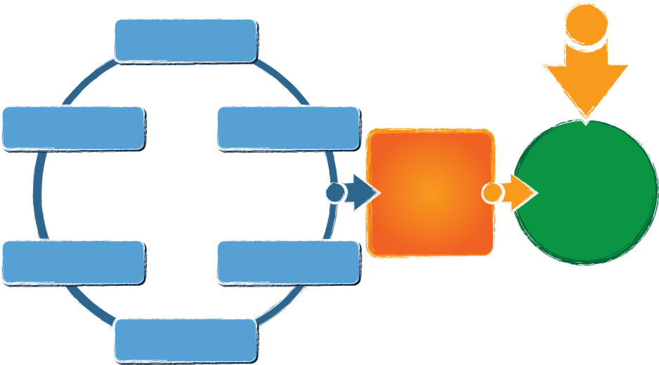
ECTA Center System Framework
What does a state need to put into place in order to encourage, support, require local implementation of effective practices?
Governance
Finance
Personnel / Workforce
Data Systems
Accountability & Quality Improvement
Quality Standards
Result:
Implementation of effective practices
Good outcomes for children with disabilities and their families
Available from: http://ectacenter.org/sysframe
Notes:
What does a state need to put into place in order to encourage, support, require local implementation of effective practices?
Governance
Quality Standards
Finance
Accountability & Quality Improvement
Personnel/Workforce
Data Systems
(leading to)
Implementation of effective practices
(leading to)
Result: Good Outcomes for children with disabilities and their families

Slide 20
Governance
Finance
Vision, Mission, Purpose
Legal Foundations
Administrative Structures
Leadership and Performance Management
Finance Planning Process/ Forecasting
Fiscal Data
Procurement
Resource Allocation, Use of Funds and Disbursement
Monitoring and Accountability of Funds and Resources

Slide 21
Personnel/Workforce
Data Systems
Leadership, Coordination & Sustainability
Personnel Standards
Preservice PD
Inservice PD
Recruitment & Retention
Evaluation
Purpose & Vision
Data Governance & Management
Stakeholder Engagement
System Design/Development
Data Use
Sustainability

Slide 22
Accountability & Quality Improvement
Quality Standards
Planning for Accountability & Improvement
Collecting & Analyzing Performance Data
Using Results for Continuous Improvement
Child Level Standards
Program Standards

Slide 23
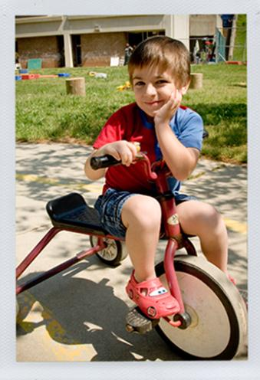
Cross cutting themes
Engaging stakeholders, including families
Establishing/revising policies
Promoting collaboration
Using data for improvement
Communicating effectively
Family Leadership & Support
Coordinating/Integrating across early childhood

Slide 24
Framework Timelines
All components drafted and posted online by the September 2014
Glossary and self-assessment will be posted Fall/Winter 2014
Corresponding resources will be added over the next year and ongoing
Framework content is part of ongoing ECTA TA services and will be supporting states with self-assessment and improvement planning

Slide 25
Small Group Discussion
Each small group focuses on one of the three areas: assessment, family, or teaming and collaboration
Small groups review and discuss:
How are these practices working in my state/program? (home/classroom)
What are the biggest challenges related to implementing these practices?
What are the biggest successes related to the practices?
Whole group sharing/debrief

Slide 26
Video: Talina Jones
What do you think about what Talina shared?
What was important or helpful for professionals?

Slide 27
Return to Small Groups
Given the video, are there implications for your thinking?
Are there things you would like to do differently?
What would you change in your program?
Governance
Finance
Data systems
Standards
Accountability
Personnel (PD and TA)

Slide 28
Look for updates via the web site: http://ectacenter.org/sysframe

