Slide 1



Using the Child and Family Outcomes Analysis Tools
Siobhan Colgan, DaSy, IDC
Abby Winer, ECTA, DaSy
September 8, 2014
Improving Data, Improving Outcomes Conference
New Orleans, LA

Slide 2
Purpose
Discuss available child and family outcomes analysis tools
Demonstrate tools
Gather suggestions and ideas for new tools
Notes:
Description: This informal session will involve a discussion of the data analysis tools developed by the outcomes team at ECTA and the ECO Center. Presenters will demonstrate the use of tools for broad and drill down analysis, graphing your state and local outcomes data, and excel calculators for APR calculations. Both child and family outcomes data tools will be presented. Ideas for new data tools needed by states are also welcomed.

Slide 3

Broad Data Analysis Tools

Slide 4
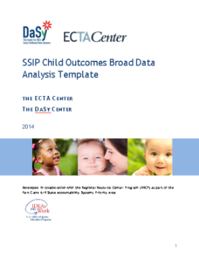
SSIP Child Outcomes
Broad Data Analysis Template
Purpose
To assist states in conducting an initial data analysis using child outcomes APR data.
Analyses
State performance relative to national data, across years, and across programs within the state
http://ectacenter.org/eco/assets/docs/SSIP_child_outcomes_broad_data_analysis_template_FINAL.docx
Notes:
Ok, switching now to highlight a number of resources that are available to you.
This is a newly developed resource from the DaSy and ECTA Center is the SSIP Child Outcomes Broad Data Analysis Template.
The purpose of the template is to help states look at how children in the state are performing relative to national data, across years, within the state and by comparisons across programs within the state. This template has been developed to assist Part C and Section 619 in conducting an initial broad data analysis.
The format of the resource is simply an explanation of a particular data analysis (for example, the comparison of state to national data) followed by example charts that illustrate the analysis.

Slide 5
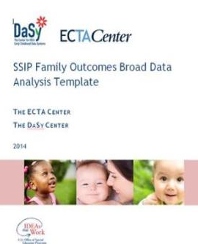
SSIP Family Outcomes
Broad Data Analysis Template
Purpose
To assist states in conducting initial analysis using family APR data.
Analyses
Family data comparisons to national, states with comparable survey approaches, across years, and across programs
http://ectacenter.org/eco/assets/docs/SSIP_family_outcomes_broad_data_analysis_template.docx
Notes:
Abby

Slide 6
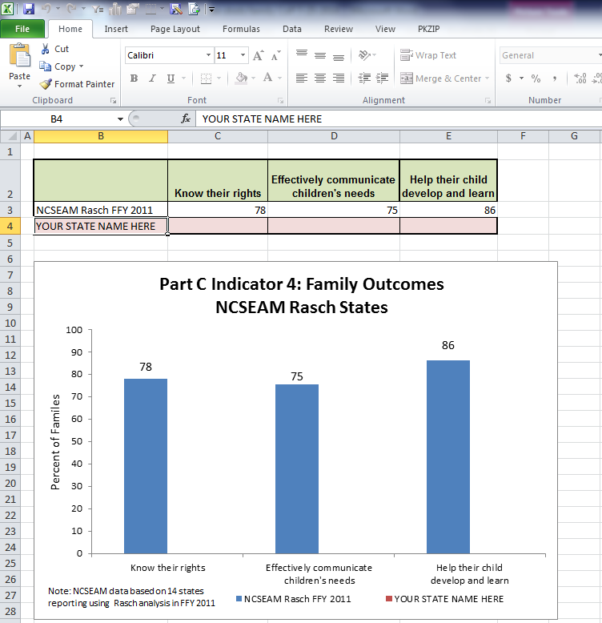
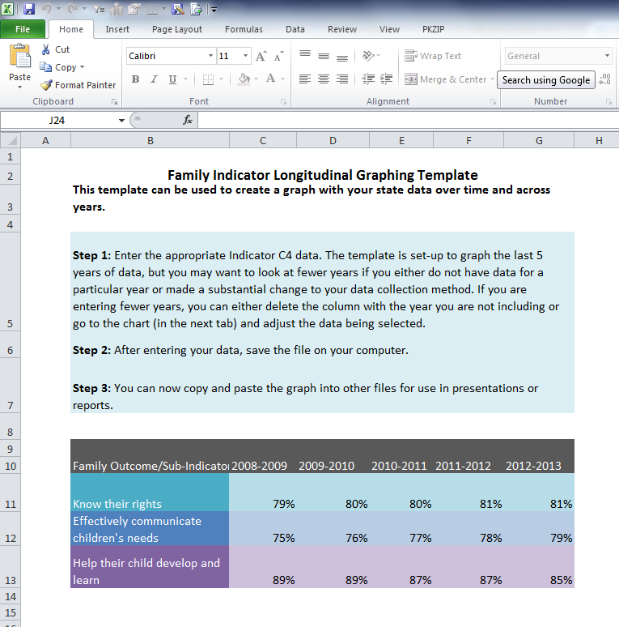
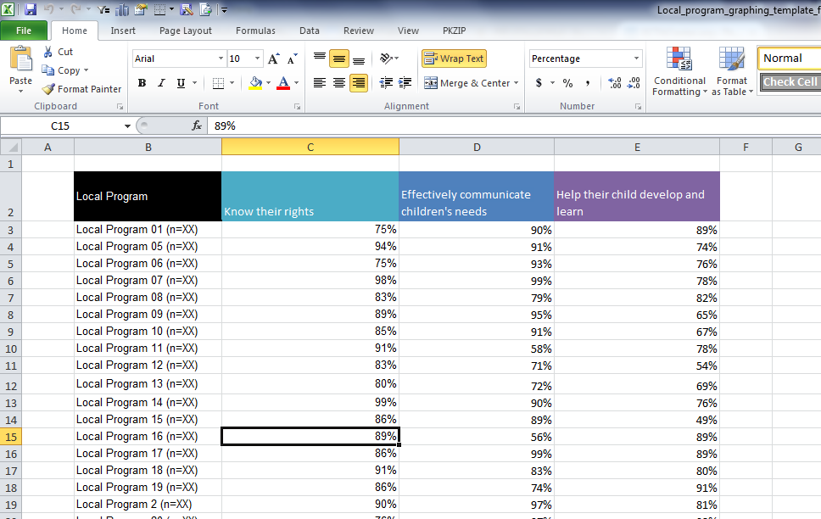
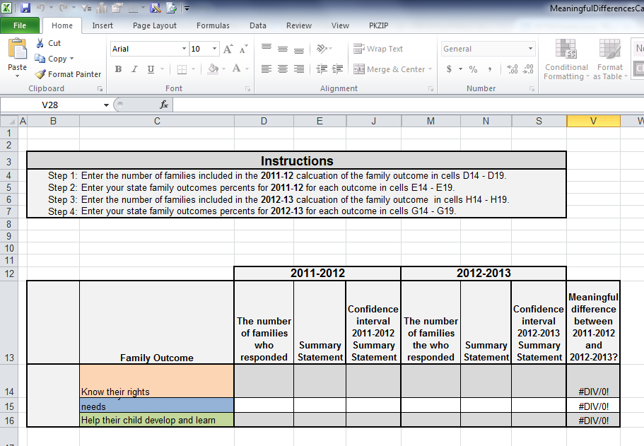
Graphing Templates & Calculators
Several new excel-based graphing templates and calculators for child and family outcomes
State to National / State by Survey Approach
ITCA Eligibility Category
Longitudinal Data
Local Programs to State
Meaningful Differences Calculator
Notes:
Abby
Go to excel documents

Slide 7

In-Depth & Drill Down Analysis Tools

Slide 8
In-Depth & Drill Down Analysis Tools
Purpose
To provide states with outlines for suggested subgroup analyses for both child and family outcomes.
To share analyses that have proven useful in understanding variability in outcomes data across states
Usefulness
As a component of data quality checks
Part of SSIP analysis and planning
Developing targeted improvement strategies
To providing in-depth data to districts or local programs

Slide 9
SSIP Child Outcomes
Subgroup Analysis Template
Purpose
To provide states an outline for suggested subgroup child outcomes analyses, proven useful in understanding predictors of child outcomes
Analyses examples
Progress categories & summary statements by…
  Age at entry
  Disability category
  Primary language
  Poverty level
  Race and ethnicity categories
http://ectacenter.org/eco/assets/docs/subgroupdataanalysistemplate.docx
Notes:
We’ve recently developed this resource – the Subgroup Analysis Template which is designed to provide states with table shells for subgroup analyses that have proven useful in understanding predictors of child outcomes. These shells are suggestions and can be tailored to fit the appropriate categories for your state.

Slide 10
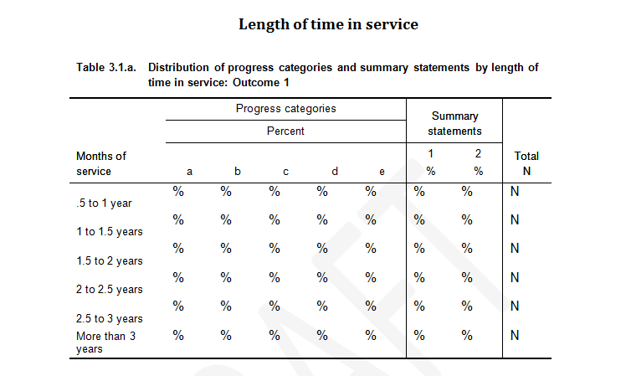
Child Subgroup Analysis Example
Notes:
Here’s an example of a subgroup analysis presented in the resource. This is a table that would allow you to compare the % of children that fall into each of the a-e categories and summary statements by length of time in service. So, this type of analysis could help you answer questions about length of time in service and how that relates to the amount of progress children make in the program.

Slide 11
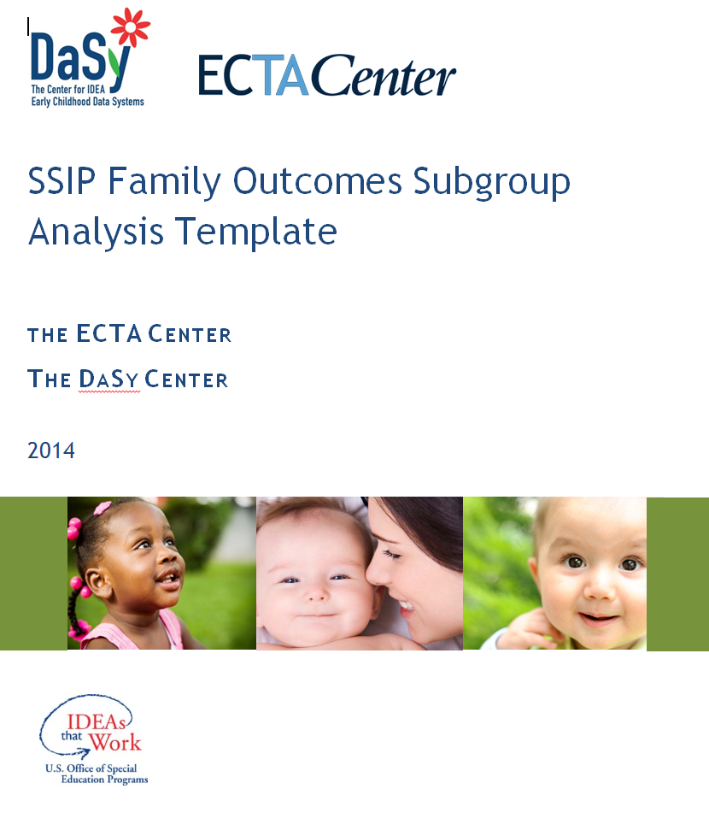
SSIP Family Outcomes
Subgroup Analysis Template
Purpose: Outlines suggested subgroup family outcomes analyses
Analyses examples
Families reporting early intervention has helped them in the three indicator areas by…
  Length of time in services
  Disability category
  Primary language
  Poverty level
  Race and ethnicity categories
Notes:
Melissa
After providing introduction, go to word document

Slide 12
Family Subgroup Analysis Example
Notes:
Here’s an example of a subgroup analysis presented in the resource. This is a table that would allow you to compare the % of children that fall into each of the a-e categories and summary statements by length of time in service. So, this type of analysis could help you answer questions about length of time in service and how that relates to the amount of progress children make in the program.

Slide 13

Analyzing Child Outcomes Data for Program Improvement
Quick reference tool
Guidance on identifying key issues, questions, and approaches for analyzing and interpreting child outcomes data
Describes iterative steps in using data, eg:
  Stakeholder processes
  Expected relationships in your data
  Evidence, inference, action cycles
  Implementation and systematic evaluation
http://www.ectacenter.org/~pdfs/eco/AnalyzingChildOutcomesData-GuidanceTable.pdf
Notes:
A third resource we want to highlight is a guidance document on Analyzing Child Outcomes Data for Program Improvement
We first shared this tool maybe about a year ago and we think it’s very relevant now for the SSIP process.
This is a tool to help identify key issues, questions, and approaches for analyzing and interpreting data on outcomes. The tool basically outlines a series of steps related to defining analysis questions, clarifying expectations, analyzing data, testing inferences, and conducting data-based program improvement planning.

Slide 14
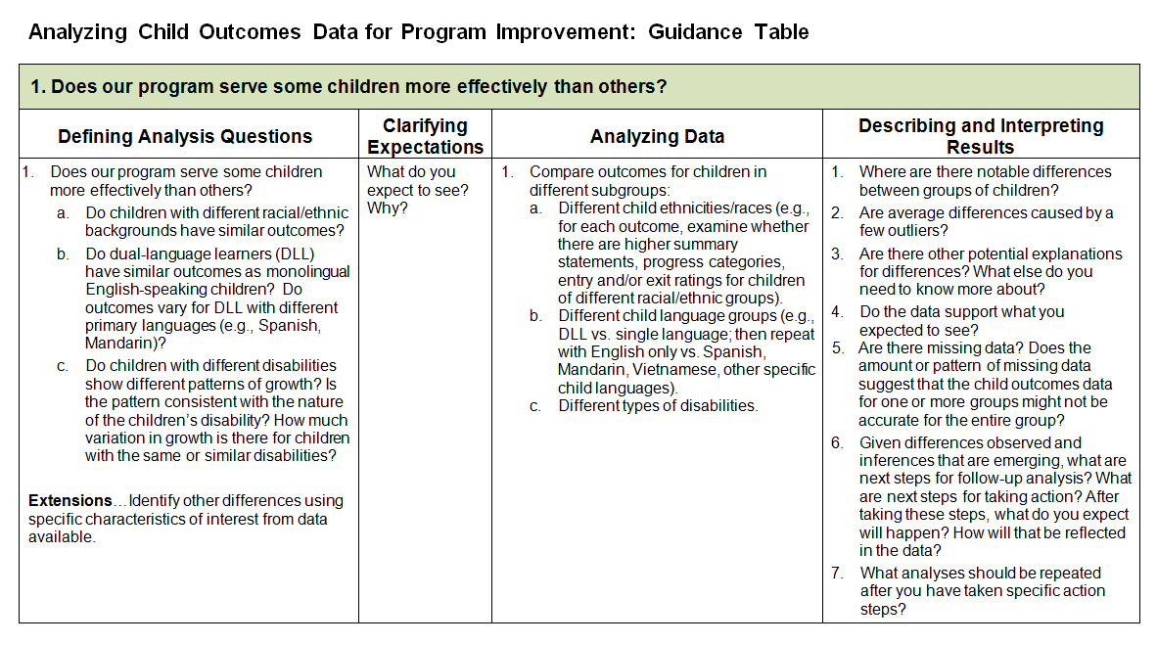
Guidance Table
Notes:
Here’s a look at the guidance table inside the document. It’s organized by key analysis questions that your state might have.
It begins with a key analysis question – “Does our program serve some children more effectively than others?”
And each column walks you through the process of...
...further defining the analysis question
... Clarifying expectations – what do you expect to see and why?
... Analyzing the data ... What are the data fields and analyses that actually need to be conducted
... And Describing and interpreting the results

Slide 15

Data Quality Tools

Slide 16
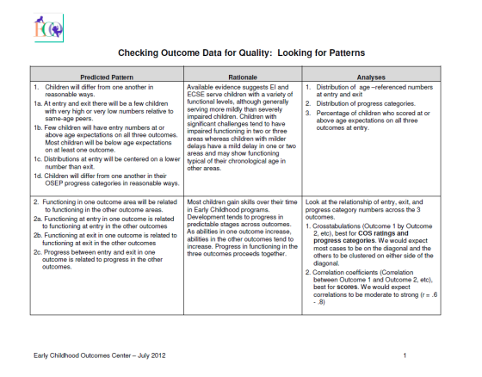
Data Quality: Pattern Checking
Checking predictable patterns to help determine ‘red flags’ to be investigated in the data.
http://ectacenter.org/eco/assets/pdfs/Pattern_Checking_Table.pdf
Notes:
A key ECO resource that has been out for several years is this Pattern Checking table which shows predicted patterns, rationale for those predicted patterns, and the types of analyses you would run to check those patterns in your own state data. Running these analyses is an important way to determine if you have any ‘red flags’ in your data that need to be investigated ... Which might lead to additional training and support around data collection and reporting.

Slide 17
Discussion
What are your successes and challenges in your experience working with these tools?
What are your suggestions for enhancements to the existing tools?
What ideas do you have for new tools?

Slide 18
Where to Find These and Other Resources
SSIP Data Analysis Templates (Broad and Subgroup):
  http://ectacenter.org/eco/pages/usingdata.asp#ResourcesandTools
Graphing templates (longitudinal and local):
  http://ectacenter.org/eco/pages/summary.asp#nationalfamilyoutcomesdata
Meaningful differences calculators:
  http://ectacenter.org/eco/pages/summary.asp#meaningfuldiffcalc
Additional data quality resources
  http://www.ectacenter.org/eco/pages/quality_assurance.asp
Data analysis for program improvement
  http://www.ectacenter.org/eco/pages/usingdata.asp
Notes:
Siobhan

Slide 19

Find Even More Resources At:
http://www.ectacenter.org/eco
Notes:
Abby
You will be getting an evaluation link – please fill it out for our own continuous improvement efforts.

