Slide 1
Child Outcomes Data Analysis Workshop
Abby Winer, ECTA, DaSy
Kathy Hebbeler, ECTA, DaSy
Kathi Gillaspy, ECTA, DaSy
September 8, 2014
Improving Data, Improving Outcomes Conference
New Orleans

Slide 2
Welcome and Introductions
Who has joined us today?

Slide 3
Today’s Workshop
Overview of child outcomes and framework for analyzing data
Activity 1: Assessing data quality and state performance
Identifying analyses to support interpretation of the data
Activity 2: Reviewing local program data
*Break*
Measuring practices
Activity 3: Linking practices to child outcomes

Slide 4
Goal of Today’s Workshop
Provide examples and help stimulate your thinking about ways to analyze child outcomes data related to:
Data quality
Assessing state performance
Examining local programs
Gathering information about practices
Linking practices to outcomes

Slide 5
Ground Rules
Ask for clarification if you are confused
If something isn’t clear, raise your hand and ASK!
Take responsibility for your own learning and the quality of the discussion
Build on one another’s comments; work toward a shared understanding

Slide 6
Child Outcomes
States are required to report on the percent of infants and toddlers with Individualized Family Service Plans (IFSPs) or preschool children with Individualized Education Plans (IEPs) who demonstrate improved:
Positive social-emotional skills (including social relationships);
Acquisition and use of knowledge and skills (including early language/communication [and early literacy]); and
Use of appropriate behaviors to meet their needs.

Slide 7
Progress Categories
Percentage of children who:
did not improve functioning.
improved functioning but not sufficient to move nearer to functioning comparable to same aged peers.
improved functioning to a level nearer to same aged peers but did not reach it.
improved functioning to reach a level comparable to same aged peers.
maintained functioning at a level comparable to same aged peers.

Slide 9
Summary Statements
For OSEP states are required to report on two summary statements for each of the three child outcomes:
Summary Statement 1 : Of those children who entered the program below age expectations in each Outcome, the percent who substantially increased their rate of growth by the time they exited the program.
(c+d)/(a+b+c+d)
Summary Statement 2 : The percent of children who were functioning within age expectations in each Outcome by the time they exited the program.
(d+e)/(a+b+c+d+e)

Slide 10
Value of Child Outcomes Data
Federal government is driving force behind child outcomes data collection
But there are many reasons to collect and use the child outcomes:
Examine program effectiveness
Use data for program improvement
Ultimately, to better serve children and families

Slide 11
Evidence
Inference
Action
11

Slide 12
Evidence
Evidence refers to the numbers, such as
“45% of children in category b”
The numbers are not debatable
12

Slide 13
Inference
How do you interpret the #s?
What can you conclude from the #s?
Does evidence mean good news? Bad news? News we can’t interpret?
To reach an inference, sometimes we analyze data in other ways (ask for more evidence)
13

Slide 14
Inference
Inference is debatable -- even reasonable people can reach different conclusions
Stakeholders can help with putting meaning on the numbers
Early on, the inference may be more a question of the quality of the data
14

Slide 15
Action
Given the inference from the numbers, what should be done?
Recommendations or action steps
Action can be debatable – and often is
Another role for stakeholders
Again, early on the action might have to do with improving the quality of the data
15

Slide 16
Data Quality
Methods for identifying child outcomes data quality issues
Pattern checking analysis
Data system checks
Data quality reviews (e.g., record reviews, COS reviews)
Surveys with local programs

Slide 17
Looking for Patterns in the Data
National Analysis – minimum quality criteria
Estimate of completeness
Odd patterns in progress categories
State % in ‘a’ is not overly high (>10%)
State % in ‘e’ is not overly low (>5%) or high (>65%)
What might be other ‘odd’ patterns in the a-e data?
State % in ‘b’ is not overly low (< 5%) or high (> 50%)
State % in ‘c’ is not overly low (< 5%) or high (> 50%)
State % in ‘d’ is not overly low (< 5%) or high (> 50%)

Slide 18
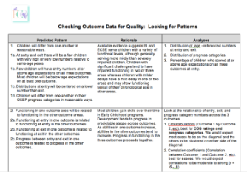
Checking Outcome Data for Quality: Looking for Patterns
Guidance tool for the different types of analyses to look for predictable patterns in child outcomes data to establish quality.
Children will differ from one another in reasonable ways.
Functioning at entry in one outcome area will be related to functioning at exit in the same outcome area (e.g. comparing Outcome 1 entry and Outcome 1 exit).
Similar programs should have similar results
http://ectacenter.org/eco/pages/quality_assurance.asp
18

Slide 19
Data Quality Profiles
Comparison to national
Inclusion criteria in the national estimate
Completeness
Progress category patterns for ‘a’ and ‘e’
Comparisons and trends over time

Slide 20
How Can You Improve Data Quality?
Training
Initial/orientation, refreshers, regular opportunities
Technical assistance
Ongoing support, mentoring, supervision with feedback
Guidance materials development and dissemination
Manuals
Data analysis and use at state and local levels
Data quality review process and follow up
Pattern checking analysis and follow up
Data review with local programs
Data system checks and follow up

Slide 21
Activity 1
Data Quality & Broad Data Analysis

Slide 22
Activity 1 Debrief
What patterns or trends did you notice in the state’s performance?
What issues did you identify related to data quality?
What outcomes did you recommend for further analysis?
What other comparisons would you like to make?
What additional data or information would you like to see?

Slide 23
Identifying Analyses to Support Interpretation of the Data
Distinguishing programs with poor data quality and programs with poor child outcomes
Utilize information about the programs who are struggling and those that are doing things well
Procedural issues may be indicative of bigger issues around service delivery
Child outcomes data can validate what you know qualitatively and anecdotally
IF ... THEN…

Slide 24
Draw on What You Know
Infuse evidence based practice in your work
Look at programs with enough data and look at whether the child outcomes substantiate what you know about the programs
What you know about the program’s service delivery, and
How seriously they are taking the child outcomes measurement?

Slide 25
Group Discussion
What are the sources of information that you have about how well a local service system is functioning?

Slide 26
Local Program Data
Review and interpret local data patterns
Compared to the state
Compared to other local programs
Compared to expectations (what you know)
Compare year to year trends
Progress category patterns
Type of assessment(s) used

Slide 27
Challenges with Numbers Based on Small Ns
A program with 5 exiting children:
2009-10 4 of 5 exit at age expectations SS2 = 80%
2010-11 2 of 5 exit at age expectations SS2 = 40%
2011-12 3 of 5 exit at age expectations SS2 = 60%
In this example a difference of 1 child changes the summary statement by 20 percentage points

Slide 28
A Range Masquerading as a Number
When you compute a percentage or an average, there is a range of likely values around the percent or average.
The more children used to compute the percent of average, the more narrow this range of likely values is.
47%
(27 – 67%)
28

Slide 29
Why Do You Care?
Issues with ...
Comparison of actual to target
Comparisons across local programs
Comparisons over time
29

Slide 30
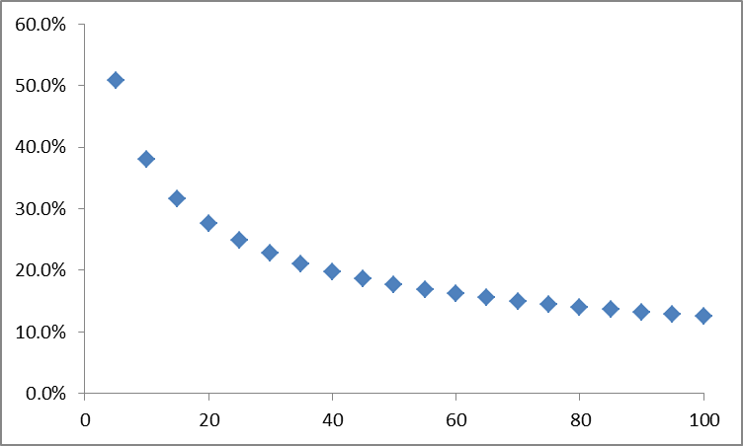
Amount of Error by N Size (2 – 100)

Slide 31
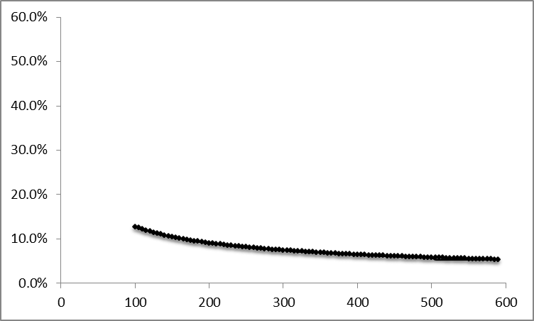
Amount of Error by N Size (100 – 600)

Slide 32
What to Do about It?
Determine other ways to measure the effectiveness of the programs
Qualitative summary of the progress made by children including detail about child and family characteristics
Use a different subset
Sum across multiple years
Look at all children receiving services not just those exiting
If possible, limit across program comparison to programs with at least 30 children.
32

Slide 33
Planning for Follow-up Analyses
Analysis planning
Asking a question – what else do you want to know
Generating hypotheses
Identifying data sources, including comparisons (what groups to compare, how to put together groups)
For more examples from other states, attend the Preventing Data Analysis Paralysis session (S86)
For hands-on guidance on identifying hypotheses and data elements to answer your questions, attend the post-conference workshop, Questions, Data, and Reports: Connecting the Data Dots Using the DaSy Framework System Design and Development Component (W04)

Slide 34
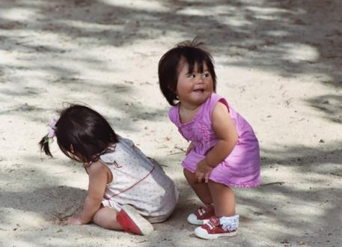
Activity 2
Reviewing Local Program Data

Slide 35
Activity 2 Debrief
What patterns or trends did you notice in the local program data?
What concerns did you have about data quality for local programs?
What programs would you target for more in-depth analysis?
What else would you want to know about those programs?
What would your hypotheses be?

Slide 36
BREAK!

Slide 37
Examining Practices
Different methods/approaches for examining and measuring practices:
Sampling IFSP outcomes/IEP goals
Surveys to programs – implementation survey
Interviewing programs – Local Contributing Factors Tool
Supervisor observation
Monitoring data

Slide 38
Linking Practices to Outcomes
How can you take qualitative information about practices and link it to quantitative child outcomes data?
Take qualitative information and divide into categories
Group programs on similar qualities
Some ways to categorize programs
Implementing or not
Implementing full, partial, planning, not planning
Quality practices: high, medium, low
Type of assessment being used
Other examples for categorizing/assessing practices?

Slide 39
Relationship between Quality Practices and Child and Family Outcomes
Includes key quality practices that have direct impact on child and/or family outcomes
All practices impact all child and family outcomes but:
✰ - most direct impact
✓ - lesser, yet still direct, impact

Slide 41
Activity 3
Linking Practices to Child Outcomes

Slide 42
Activity 3 Debrief
How did practices differ between the high and low performing programs?
What ideas did you generate for possible interventions, system changes or strategies to implement?
Any different strategies based upon the program?

Slide 43
Wrap-Up
Questions, reactions?
Additional ideas for measuring and evaluating practices?
Any states that have already done work to examine practices in relation to outcomes?

Slide 44
Thank You!
45

