Slide 1
Program Quality and Child Outcomes: The Role of QRIS and its Relationship to Early Childhood Special Education
Beth Rous, University of Kentucky
Rena Hallam, University of Delaware
Verna Thompson, Delaware Department of Education
Donna Spiker, SRI
Measuring Child and Family Outcomes Conference 2011

Slide 2
Session Overview
QRIS from a national perspective (Beth)
Delaware’s experiences (Rena and Verna)
Future possibilities (Donna)
Discussion (All)

Slide 3
What is a QRIS?
Common Elements
Quality standards
Process for assessing/monitoring standards
Outreach and support to programs
Financial incentives
Consumer awareness
http://nccic.acf.hhs.gov/qrisresourceguide

Slide 4
QRIS Across the U.S.

Slide 5
Quality Standards
Licensing compliance
Ratio and group size
Health and safety
Curriculum
Environment
Child assessment
Director, teacher, provider qualifications
Family partnership
Administration and management
Cultural and linguistic diversity
Accreditation
Provisions for children with special needs
Community involvement
Notes:
p. 43 of Compendium has brief definitions of each of these.

Slide 6
Assessing Observed Quality in QRIS
23 of 26 states with QRIS use an observation measure of quality
Most use the Environment Rating Scales (ERS)
A few (e.g., Virginia, Minnesota) use the Classroom Assessment Scoring System (CLASS)
Individual states use other measures
Notes:
Missouri uses the ECERS-E that focuses on curriculum, Vermont uses the Essential Practices Inventory.
Environment section of Compendium starts on p. 88

Slide 7
Children with Special Needs
8 of 26 states address for centers
6 of 26 states address for family child care homes
Specialized training
Screening procedures
Planning for children with special needs
Documentation of plans & activities
Environmental accommodations
Notes:
Delaware: For a 5 star, staff are available to attend IEP/IFSP meetings for joint planning
In Compendium, this information is on p. 153

Slide 8
RTT-Early Learning Challenge
QRIS Program Standards
Early learning and development standards
Comprehensive assessment system
Early childhood educator qualifications
Family engagement strategies
Health promotion practices
Effective data practices
Absolute priority about Children with High Needs
Notes:
RTT-ELC is already changing the conversation to bring together the ece and ecse worlds to think about QRIS. States applying for RTT-ELC must think about how their QRIS addresses
The needs of “Children with High Needs”—which includes children with disabilities.
RTT-ELC also talks about the importance of conducting appropriate assessments of young children and using the assessment information appropriately to support the development and learning of all children, particularly children with high needs. The early childhood special education/early intervention world has a lot of wisdom to provide.

Slide 9
Resources
http://www.acf.hhs.gov/programs/opre
Compendium of Quality Rating Systems and Evaluations
State Profiles

Slide 10
Rena Hallam
Delaware Institute for Excellence in Early Childhood, University of Delaware
Verna Thompson
Delaware Department of Education
September, 2011

Slide 11
Presentation Outline
Overview of Delaware Stars for Early Success
Historical Perspective on QRIS development and integration with services for young children with disabilities
Current Status of Delaware Stars
Framework for QRIS redesign and next steps

Slide 12
Delaware Stars
Voluntary QRIS implemented in 2007 to serve all types of licensed child care in Delaware.
5 Star Levels with successive quality requirements in four program areas:
Learning Environments and Curriculum
Program Administration and Management
Family and Community Partnerships
Professional Development and Qualifications
Benefits of program participation include:
Technical Assistance
Grants and Awards
**Tiered Reimbursement to be implemented October, 2011

Slide 13
Historical Perspectives on Initial Development
Vision (2005)
All of Delaware’s children and families will have access
to quality early care and education from birth through
school-age.
One of the primary reasons for creating QRIS system in Delaware
Provide quality learning environments for children with disabilities and children at risk
QRIS standards
Initial Standards- Indicator for serving children with disabilities (staff training on inclusion, implementing IEP activities)
Later standards -Removed indicator for disabilities and embedded information in standards

Slide 14
Current Status of Delaware Stars
Challenges in participation rates and program movement through the star levels
New Governor’s initiative in early childhood increased subsidy rates and created a tiered reimbursement system
Stars in currently in a redesign and ramping up phase.

Slide 15
Current Participation and Ratings (n=181)

Slide 16
What Have We Learned?
Many programs are getting “stuck” at low levels of the rating system
Too much focus on paperwork, too little focus on practice
Great variability in accessing resources and supports from Delaware Stars
Providers need more flexibility and more responsive TA
System is struggling to improve quality of care for all children

Slide 17
Foundation for QRIS Redesign
Practice Principles
Continuity of Care
Inclusive Practice
Intentionality
Systems Principles
Increase visibility of state infrastructure to promote quality
Align quality infrastructure in ways that makes sense to programs
Collaboration with Key Stakeholders
Implementation Principles
Use data to inform technical assistance
Use recommended technical assistance practices; diversify our strategies
Engage programs more effectively

Slide 18
State Quality Infrastructure
Early Learning Foundations
Personnel Competencies
Delaware Early Childhood Career Lattice
PROGRAM
QUALITY

Slide 19
Current Collaborative Efforts between QRIS and Services for Young Children with Disabilities
Inclusion of new indicators related to young children with disabilities across all four dimensions of program quality in QRIS
Indicator Review – state-level review and input from cross-agency Expanding Inclusive Early Intervention Opportunities (EIEIO) group
Support for Inclusion Credential for child care personnel
Sharing QRIS information with 619 providers – TA opportunities

Slide 20
Next Steps for Delaware
Race to the Top Early Learning Challenge Grant Application
QRIS system needs to include programs serving children with disabilities
Increased emphasis on recruitment and support to programs serving high proportions of low-income children
Stars “Plus”
Higher intensity support to high need programs delivered in a cohort model

Slide 21
Measuring Quality of ECE Programs for Children with Disabilities
Donna Spiker
Measuring & Improving Child & Family Outcomes Conference, New Orleans, LA
September 2011

Slide 22
Quality Framework
Based on a book chapter:
Spiker, D., Hebbeler, K., & Barton, L. (2011). Measuring quality of ECE programs for children with disabilities. In M. Zaslow, K. Tout, T. Halle, & I. Martinez-Beck (Eds.), Measuring quality in early childhood settings. (pp. 229-256). Baltimore, MD: Paul H. Brookes Publishing Company.

Slide 23
Four types of participation in the ECE system for young children with disabilities
C1
Integrated program
A
General early care and education
(GECE)
B
IDEA supports and services
(EI/ECSE)
Discrete programs
C2

Slide 24
Critical quality questions
Does this general early care and education (GECE) program provide a high-quality experience for children with disabilities?
Does this EI/ECSE program provide high-quality services?
Are the GECE program and the EI/ECSE program coordinating well to provide a high-quality experience for children with disabilities?

Slide 25
Considerations related to measuring program quality for children with disabilities
Common elements of quality (DAP) such as:
Instructional practices to promote learning
Teacher-child interactions
Assessment practices
Use of materials & physical environment
Individualization: Adaptations & accommodations
Program quality versus Individualized quality
Implementing the child’s OFSP or IEP
Parent Partnerships

Slide 26
Proposed framework for program quality for children with disabilities: Major areas, with related concepts and examples

Slide 27
Major Area # 1. Interactions
Interactions with peers
Interactions with adults

Slide 28
Major Area #1. Interactions: Related concepts and examples
Presence of typically developing children
Adult facilitation and support of child’s interaction with peers
Adult use of appropriate techniques to address challenging behavior
Adult implementation of specialized techniques to facilitate language development

Slide 29
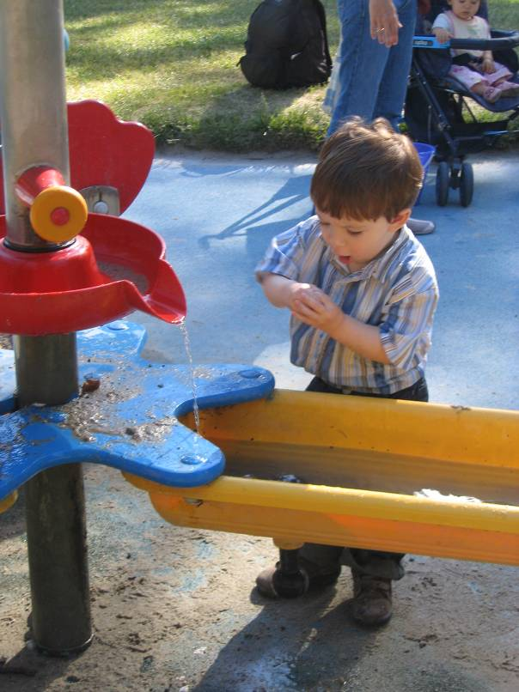
Major Area # 2. Program features
Curriculum
Instructional practices
Scheduling
Nature of activities
Materials

Slide 30
Major Area # 2. Program Features: Related concepts and examples
Curriculum modifications and adaptations
Instructional practices geared to child’s needs
Use of everyday routines to promote development and learning
Availability of specialized materials
Full engagement of child in activities
Implementation of IFSP/IEP
Developmentally appropriate and functional goals
Integration of specialized services

Slide 31
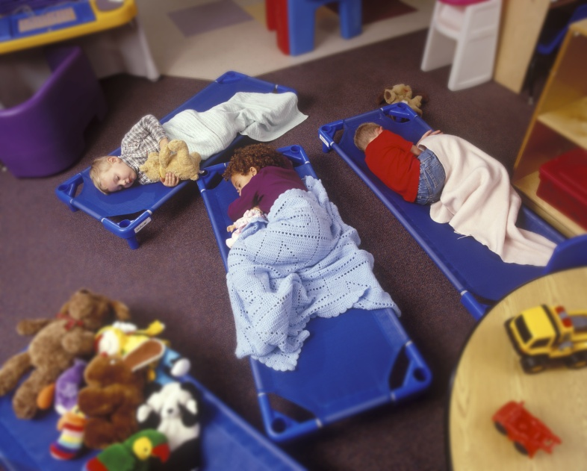
Major Area # 3. Staff characteristics & program structure
Staff education
Staff training
Experience
Beliefs
Goals
Child-to-staff ratios
Group size
Arrangement of physical space, equipment, furnishings

Slide 32
Major Area #3. Staff characteristics & program structure: Related concepts and examples
Professional development for staff related to children with disabilities in general and to the child’s special needs in particular
Staff support for inclusion
Reduced ratios for classes with a special needs child
Assistive technology, adapted equipment, modified physical space

Slide 33
Major Area # 4. Administrative characteristics
Philosophy (program goals, beliefs about children, families, and early education
Structures (policies, compensation)
Context (funding adequacy, accreditations, connections to other agencies)
Supports (professional development activities, availability and quality of specialists, supervision of staff)

Slide 34
Major Area #4. Administrative characteristics: Related concepts and examples
Policy voicing support for inclusion
Zero reject policy
Coordination between general and specialized programs/services
Access to specialists
Time provided to support team planning
Transdisciplinary service provision

Slide 35
Major Area #5. Parent partnerships
Communication
Program support for family outcomes
Family-centered practices

Slide 36
Major Area # 5. Parent partnerships Related concepts and examples
Services and supports designed to help parents support child’s development and learning
Staff use of parents’ knowledge of child’s strengths, needs, and interests
Ongoing communication to support continuity of experiences for child between home and center
Important decisions related to child’s programs or services made jointly by parents and providers

Slide 37
Few measures to examine program quality for children with disabilities
Two assessment tools designed to measure inclusive program practices for children with disabilities:
SpeciaLink Child Care Inclusion Practices Profile and Principles Scale
Quality Measures of Inclusive Experiences Measure (QuIEM)

Slide 38
Questions?

