Slide 1
Minnesota’s Data Analytic Partnership: Process and Impact of Cohort One and Lessons Learned for Cohort Two

Slide 2
About Minnesota
Education Lead for Part C
Part C/619 sit within the SEA’s Division of Early Learning Services with
Head Start
State Pre-K program
Early Childhood Family Education
Mandatory Early Childhood Screening program
Early Learning Services is part of a newly developed Office of Early Learning
Race to the Top/Early Learning Challenge Grant
Supportive administration

Slide 3
Invest in Early Childhood and All-Day Kindergarten
Better Early Childhood Ed
Target All-Day Kindergarten
Expanding K-12 system into a comprehensive PK-12 System
Implement clearly defined school readiness standards
Adopt PreK – 3 Literacy Standards

Slide 4
Support EC teacher observation and development
Develop assessments for learning that measure growth
Reauthorize EC Advisory Council & reestablish Children’s Cabinet
Charge Commissioner of ED with leadership of EC initiatives

Slide 5
Why…and a little How and What
Why we chose to implement the State-Local Data Analytic Partnership (DAP) process.
Why we opted for a cross-sector approach.
What we did and how.
Why we will do it all over again.
Why we will slightly modify the process to incorporate lessons learned.

Slide 6
Why MN Implemented the State-Local Data Analytic Partnership (DAP) Process
Six long years of…
…developing our measurement system
…selling the importance of the effort
…working to improve data quality
…selling the importance of the effort
…analyzing and reporting data to OSEP
…selling the importance of the effort
…participating in the Framework development
…selling the importance of the effort

Slide 7
Why MN Implemented the State-Local Data Analytic Partnership (DAP) Process
Why
How
What

Slide 8
DAP Components
State Implementation Team
Local Implementation Teams
State-Local Partnership
Quality Data
Specific Problem/Issue
Data-based decisions
Mixed-method support
Webinars, Face-to-face workshops, Team specific conference-calls

Slide 9
Why Cross-Sector?

Slide 10
What We Did…and How
Agreed to serve as a Data Analytic Partnership state
Assembled a state team
Head Start Collaboration Director
Part C Coordinator
619 Coordinator
State Pre-K Specialist
EC Data Specialist
ECSE Implementation Specialist (TACSEI)
Representative from North Central Regional Resource Center

Slide 11
State Team’s Operational Premise
Resources need to be well invested.
Children with disabilities should participate with typical peers.
Evidence-based practices exist to improve performance.
Routine use of data by teams improves performance.
There are important differences within local systems.

Slide 12
What is the problem/issue for MN-Early Childhood?
2. Better Early Childhood Education
4. Reading Well by 3rd Grade
From 2008-2011, young children with high needs in Minnesota did not make satisfactory progress.
http://education.state.mn.us/MDE/Welcome/OfficeCom/BetterSchBetterMN/index.html

Slide 13
“Children With High Needs”
Children with High Needs means children from birth through kindergarten entry who are from low-income families or otherwise in need of special assistance and support, including children who have disabilities or developmental delays; who are English Learners; or who reside on “Indian lands” as that term is defined by section 8013(6) of the ESEA; who are migrant, homeless, or in foster care; and other children identified by the State.

Slide 14
“Did Not Make Satisfactory Progress”
District failure to meet any one of the six child outcome performance targets for Part C or Preschool
Less than satisfactory progress as measured by local Head Start grantee

Slide 15
Reality Check
Approximately 427,000 children from birth to kindergarten entry live in Minnesota.
1/3 of these children live in low income families.
Child poverty in Minnesota increased 56% since 2000, compared to 18% nationally.

Slide 16
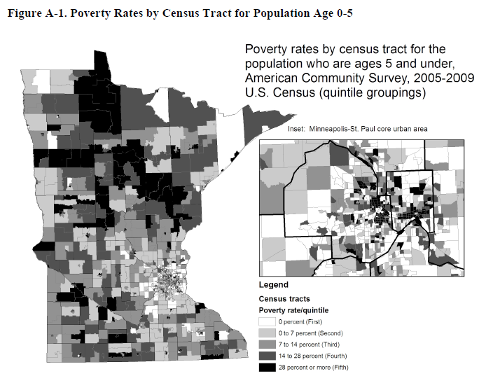

Slide 17
Other Areas of High Need
4% of young children have special needs
8% are English language learners from homes speaking more than 145 languages and dialects
4% are homeless
0.5% are in foster care

Slide 18
Application Process to Identify Local Teams
Local programs form teams of 4-10 members including:
Someone with knowledge of data and the ability to manipulate data in Excel
At least one local administrator/program leader
Member(s) with knowledge of Part C and Preschool Special Education programs
Member(s) with direct knowledge of community preschool program(s) such as School Readiness, Head Start or Early Head Start, child care, etc….

Slide 19
Selection Process
Geographic Distribution*
At least one multi-district education cooperative
Cross-sector team
Administrative commitment to process
*Travel costs for teams from Greater Minnesota were paid by the Minnesota Department of Education

Slide 20
Data Analytic Partnership: Cohort 1
Initially planned to support 6 local teams… ultimately we completed successful cycle with 7.
Inver Grove Heights
Moorhead
North St. Paul-Maplewood-Oakdale
Northland Area
Ramsey County Head Start & St. Paul Schools
South Washington County
St. Cloud

Slide 21
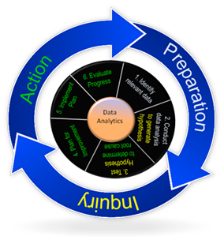
Phase 1 – Preparation (February Webinar)
Step 1: Identify relevant data/consider data quality
Phase 2 – Inquiry (February Workshop)
Step 2: Conduct data analysis
Step 3: Determine root cause
Phase 3 – Action (May Workshop)
Step 4: Plan for improvement
Step 5: Implement plan
Step 6: Evaluate progress
(September workshop)

Slide 22
Relevant Data
Part C Child Outcomes
Entry ratings, exit ratings and progress categories
Preschool Special Education Outcomes
Entry ratings, exit ratings and progress categories
Part C and Preschool Special Education enrollment records from SEA
Early childhood screening data
Head Start enrollment and assessment data
Other data collected by programs represented by members of local teams

Slide 23
Outcomes Experienced by Local Teams Generally (a.k.a. What Worked)
Cross-sector team building
Increased understanding of the universe of early childhood data available locally across sectors
Time
Shared virtual work space via Drop Box”
Focus on locally-identified root causes
Action plan
Group accountability through report out
Ability to hear from/learn from other groups

Slide 24
Lessons Learned for Cohort II
Preliminary workshop on necessary Excel skills
Sort
Filter
Add columns and rows
Subtotal
Pivot tables
Data display

Slide 25
Lessons Learned for Cohort II
Add procedural component for time with other local team members from like sectors:
Learn more about power of sector data
Share perspectives on analysis
Plan all cohort sessions for single school year
Add time and support between the initial preparation phase (identification of relevant data) and root cause analysis
Continue cross-sector aspect of process

