Slide 1
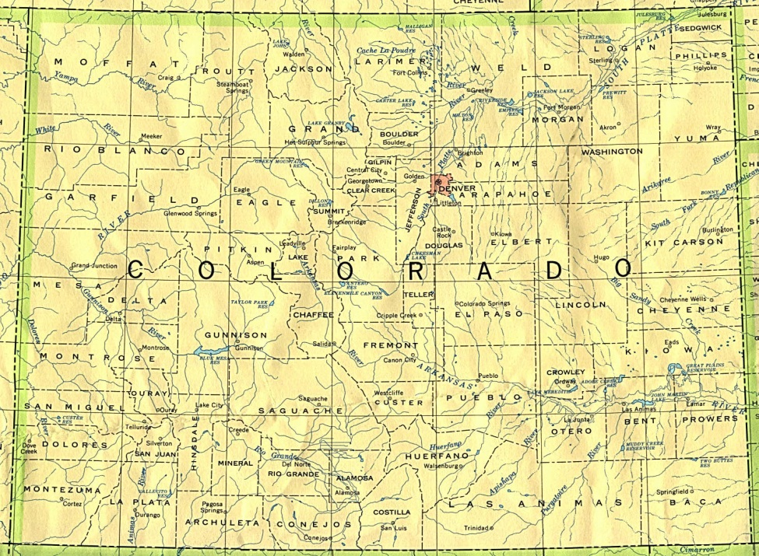
Data You Can Count On The Results Matter Roadmap to High Quality Data
Nan Vendegna Office of Early Learning Colorado Department of Education

Slide 2
Results Matter - Colorado
Authentic Assessment for Multiple Purposes
Digital Technology to Support Assessment
Large Investment in Professional Development
44,000 children birth through kindergarten
Teaching Strategies GOLD

Slide 3
Colorado’s Process From Authentic Assessment to Outcomes Data
Body of Authentic Assessment Evidence
Assessment Ratings
Child Outcome Ratings
Local Class and Program Reports
State and Federal Reports
Teacher Driven
Automated Web Based

Slide 4
Key Elements
Professional Development
Data Quality Analysis
Capacity Building

Slide 5
Professional Development
Building Assessment Skills
Observation: The Heart of Authentic Assessment
Writing Effective Observation Notes
Teaching Strategies GOLD Modules for Teachers
Just In Time Learning Opportunities in TS GOLD Online
Establishing Reliable Use of the Assessment
TS GOLD Sandbox
Results Matter Video Project and Library
TS GOLD Inter Rater Reliability Certification

Slide 6
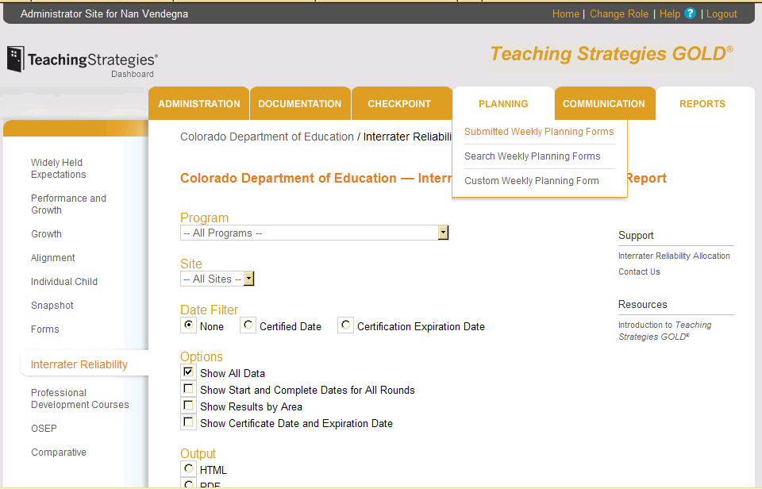
Capacity Building
Supporting Administrators
TS GOLD Administrator Training
TS GOLD Reports Features
Data Conversations
Supporting the System
Engagement of Local Early Childhood Councils
SLDS and Data Pipeline Linkages
Roundtable Stakeholder Events

Slide 7
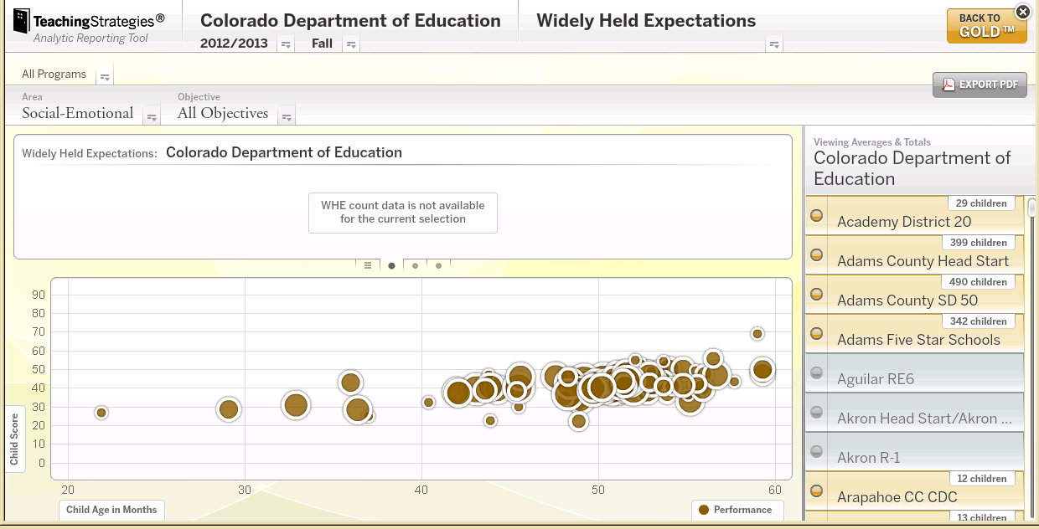
Data Analysis
Qualitative Analysis
Talks with Teachers
Self Reflection
Quantitative Analysis
Completion Checks
Inter-Rater Reliability
Pattern Analysis

Slide 8
Please Visit
Results Matter:
http://www.cde.state.co.us/resultsmatter/
Results Matter Video Library:
http://www.cde.state.co.us/resultsmatter/RMVideoSeries.htm

