Slide 1

The Child and Family Outcomes Measurement Frameworks
Donna Spiker
Early Childhood Outcomes Center
SRI International
Presented at
2012 Child and Family Outcome Conference Minneapolis, MN
October, 2012
Notes:
1
Work of the ECO Center and partner states

Slide 2
Why Child and Family Outcomes?
"Yet, ultimately, teachers, parents, and policymakers also need to know if young children are healthy, that they are developing essential social and emotional skills such as self-regulation and cooperative play, and that their emerging academic skills are developing appropriately. At the end of the day, early learning and development programs must begin to shift to evaluating the basic outcomes we seek and prize for our children.“
Secretary of Education Arne Duncan's Remarks at the National Association for the Education of Young Children Annual Conference November 18, 2009

Slide 3
System for Producing Good Child and Family Outcomes
Professional Development
Preservice
Inservice
Evidence Based Practice
High quality services and supports for children 0-5 and their families
Good outcomes for children and families
Good Federal policies and programs
Good State policies and programs
Good Local policies and programs
Strong Leadership
Adequate funding
Information infrastructure
Notes:
Part of the intentionality we need to building our systems is the availability and use of good information about the direct service component and the other components in the systems. Without good information, we are operating in a “pay and pray” mode. Without good data, we don’t know what we are buying with our money. And we don’t have the tools to identify program weaknesses and address them.

Slide 4
A good information infrastructure is an essential tool to providing high quality services and supports.
Notes:
(You cannot have data based-decision making without good data.)
This really is about children and families.

Slide 5
Early Childhood Information Infrastructure:
Data Needed for Program Improvement
WHO
SERVICES
OUTCOMES
PERSONNEL
COST
Notes:
Who –
Ages
Disabilities
Race/ethnicity
Services – what, how much, how long – part c and 619 – many different services; not so much with state operated preschool
Key questions in each area….need good data

Slide 6
Where is your state (or program) now?
WHO
SERVICES
OUTCOMES
What do you have?
How much is linked?
Early Childhood Outcomes Center
6
Notes:
6

Slide 7

A Framework and Self Assessment for Building a Child Outcomes Measurement System

Slide 8
Purpose of the framework
Provide a common language for state planning to build outcomes measurement systems
Provide a organizing structure for:
  Identifying and categorizing resources and state examples related to implementation of a COMS
  Using the state self-assessment tool
Early Childhood Outcomes Center

Slide 9
Framework and self-assessment
Framework
  Set of components and quality indicators
  Provides the structure for the self-assessment
Self-assessment
  Scale that provides criteria for levels of implementation within each quality indicator
  Rating assigned based on level of implementation within each indicator
Early Childhood Outcomes Center

Slide 10

Process for framework development
Built off what we had learned from ECO work with states and previous ECO conceptual framework
Literature review
Repeated discussion and review internally and with 7 partner states

Slide 11
Framework partner states
State | Part C | 619
California |  | X
Colorado | X | X
Delaware | X | X
Maine | X | X
Minnesota | X | X
New York | X
Ohio | X | X

Slide 12
COMS Framework Components
Purpose
Data Collection and Trans-mission
Analysis
Reporting
Using Data
Cross-system Coordination
Evaluation
Notes:
The difference between a data system and an outcomes measurement system.

Slide 13
COMS Framework Components
Purpose
The state has effective procedures for collecting, storing, and transmitting data to the state.
Data Collection and Trans-mission
Analysis
Reporting
Using Data
Cross-system Coordination
Evaluation
Notes:
The difference between a data system and an outcomes measurement system.

Slide 14
COMS Framework Components
Purpose
State coordinates child outcomes measurement and data use across EC systems.
Data Collection and Trans-mission
Analysis
Reporting
Using Data
Cross-system Coordination
Evaluation

Slide 15

Notes:
Have copies that I will pass around…and on ECO Center web site

Slide 16

Structure of self-assessment
Components (7) = Major areas of framework
  Quality Indicators (18 total) = Statements of basic requirements of a quality COMS
    Elements (number varies with each indicator) = Define what constitutes high quality on the Quality Indicator.

Slide 17
Quality indicators
Provides additional detail as to what constitutes quality implementation of the component.
18 quality indicators across the 7 components

Slide 18
The scale for the quality indicators
Implementation of Elements | Quality Indicator Score
All elements are fully implemented | 7
Nearly all elements are fully implemented and the rest are in process | 6
Most of the elements are fully implemented and the rest are in process. | 5
At least one element is fully implemented and the rest are in process | 4
All of the elements are in process | 3
Some of the elements are in process | 2
None of the elements are yet in process | 1
Early Childhood Outcomes Center

Slide 19
Quality indicators for Data Collection and Transmission
2. Data collection procedures are carried out efficiently and effectively.
3. Providers, supervisors, and others involved in data collection have the required knowledge, skills, and commitment.
4. State's method for entering, transmitting, and storing data is effective and efficient.

Slide 20

Uses of the self-assessment
  Allows states to evaluate the quality of their outcomes measurement system
  Assists states in setting priorities for improving their measurement system
  Provides information to assist states in advocating for resources for systems development

Slide 21
Features of self-assessment
Online interactive version is on the web http://www.fpg.unc.edu/~eco/pages/frame_dev.cfm
State profile page compiles overall scores
Space for notes about status on each element
Links elements to resources, state examples, and other clarifying information or definitions
Notes:
In the future watch for back-up – click on element with additional resources about state examples and information about the element

Slide 22
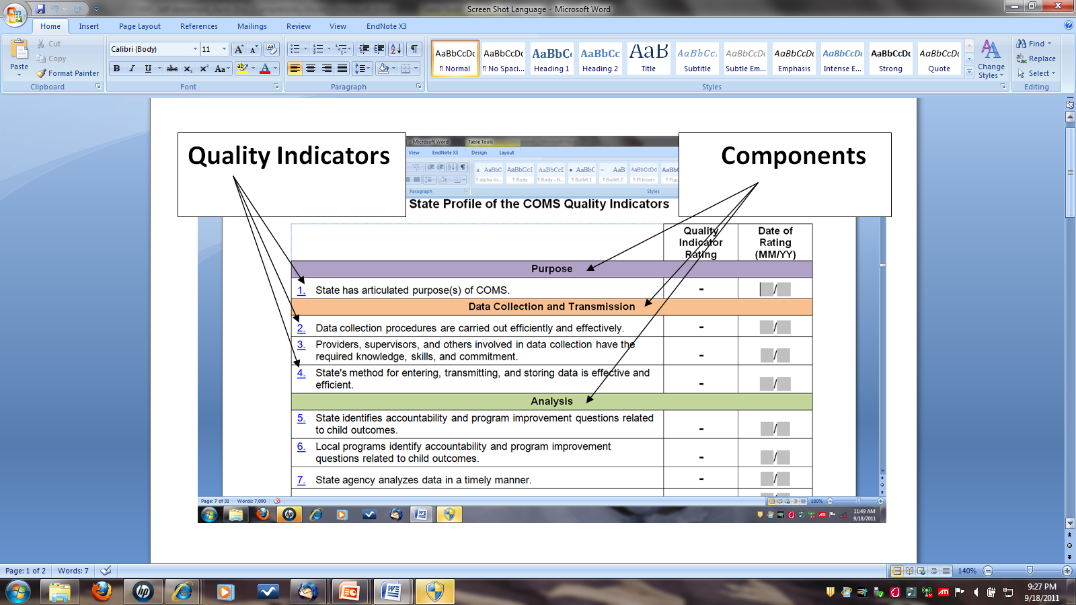
Notes:
Summary sheet

Slide 23
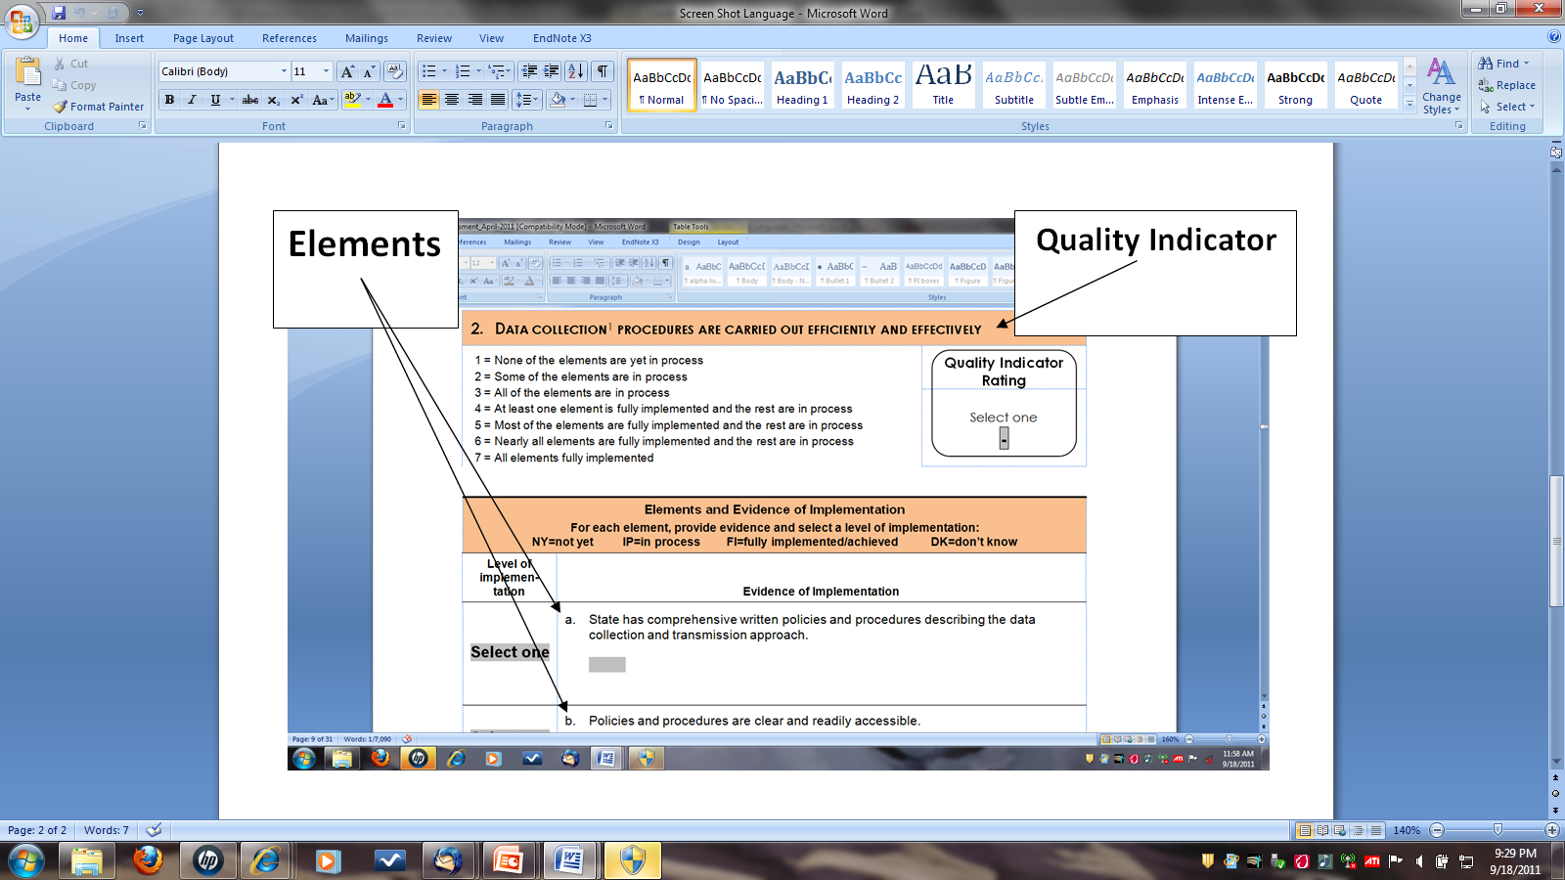

Slide 24

Suggested uses
Group of knowledgeable stakeholders
Part of an ongoing strategic planning process
Reassess periodically
May be completed in total or in sections

Slide 25
Recommended state approaches for using the self-assessment
Complete entire self assessment or specific sections.
Identify the component(s) and quality indicators to address first.
Develop action plan to improve the related elements.
Implement improvement activities.
Re-assess status and identify “next priorities at regular intervals
Notes:
We know that states are using the tool when they convene stakeholder groups to discuss their systems.

Slide 26
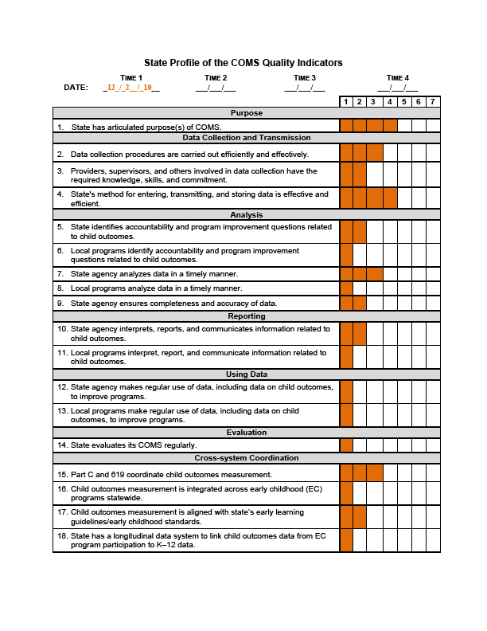

Slide 27
A Framework and Self Assessment for Building a Family Experiences and Outcomes Measurement System

Slide 28
Have you been wondering…
How well do we measure the experiences of families in our program or state?
How can we interpret our family outcomes data?
How do we know if we are heading in the right direction?
How can we prioritize improvements to our family outcomes measurement system?

Slide 29

Process of family framework development
Parallels the Child Outcomes Measurement Framework & self-assessment
ECO workgroup
Partner state workgroup
  Connecticut
  Illinois
  Minnesota
  Texas

Slide 30
Purpose of the family framework
Provides a common language and organizing structure for discussing family outcomes and experiences
Assist states in developing a measurement system that captures various aspects of family outcomes and experiences, such as
  benefits that families receive from program participation
  family satisfaction with services
  perceived helpfulness of the services
  family involvement with the service delivery system

Slide 31
Structure of family framework
Components
  7 key areas of a measurement system
Quality indicators
  15 specific statements that further describe each of the components
  1 to 5 quality indicators per component
Elements
  Various examples of what constitute quality at the indicator level

Slide 32
Uses of the self-assessment
  Allows states to evaluate the quality of their family experiences and outcomes measurement system
  Assists states in setting priorities for improving their measurement system
  Provides information to assist states in advocating for resources for systems development

Slide 33

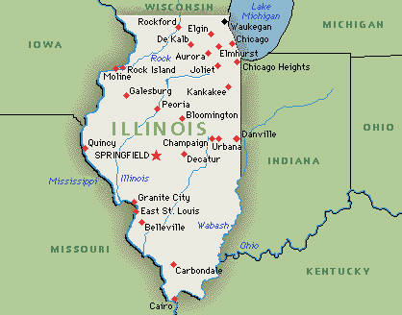
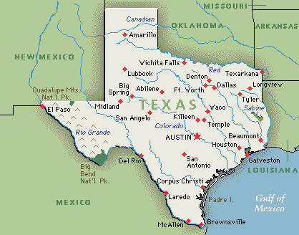
States using the self-assessment

Slide 34
Questions to consider about the using the self-assessment tools……
How might the self-assessment be useful in your state? With what process?
Who might need to be involved at different steps with the self-assessment?
What resources would be helpful to benefit the most from the self-assessment process?
How would your state begin to move from findings on the self-assessment to deciding on specific actions to improve your outcomes measurement system?

Slide 35
For more information
Materials about both the child and family outcomes frameworks and self-assessments and other resources to support the quality indicators:
www.the-eco-center.org

